Slide 1
Youth Crime Prevention Booklet
(2025 Edition)
Etomidate: Fake Cigarettes, Real Drugs — Stay Away

Slide 2
Same Matter
Different Understanding

Slide 3
Which red circle is bigger?
Which circle is blue?
Created by Prof. David Novick,
University of Texas at El Paso,
Department of Engineering

Slide 4
Smart as you are, you surely weren’t misled!
Whether you were misled or not, those illusions seemed real.
Below, these substances have different names, and each name makes people feel differently.
Drug Name | Other Name | Harms of Use
Opium | None | Addiction, drowsiness, suppressed breathing, nausea Withdrawal symptoms: watery eyes/nose, yawning, poor appetite, irritability, tremors, panic, chills, sweating, convulsions
Methamphetamine | Ice | Insomnia, depression, toxic psychosis, poor appetite, heart and kidney failure
Cocaine | Coke | Agitation, paranoia, increased sensitivity, memory loss, destruction of nasal tissue, impotence, psychosis, death
Etomidate | None | What’s the impact?

Slide 5

No matter if it’s “Space Oil” or Etomidate
https://www.nd.gov.hk/tc/etomidate.html
It’s the same substance and can lead to...
Physical convulsions
Loss of consciousness
Skin ulcers
Loss of physical control, appearing zombie-like
death

Slide 6
Drug nicknames sound appealing, making you think there’s nothing to fear
Never try it—the consequences are serious.

Slide 7
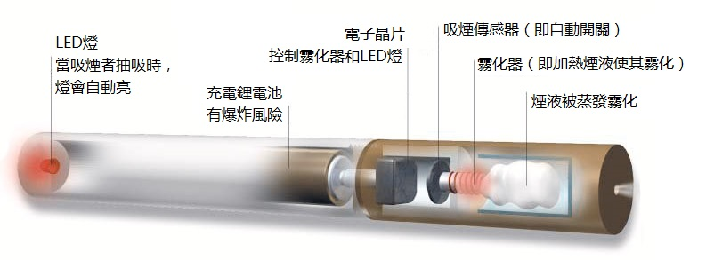
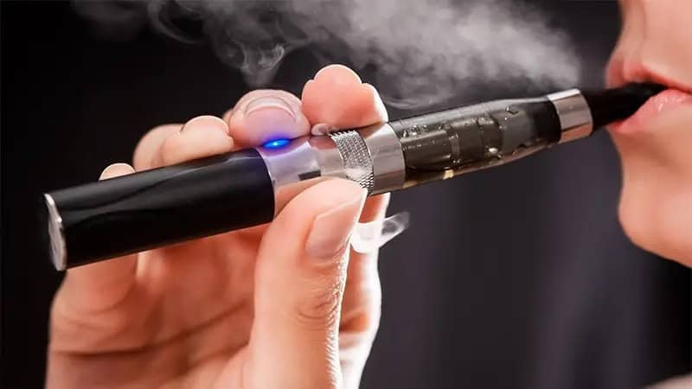
Why is Etomidate a concern?
Etomidate is a controlled narcotic.
Etomidate can be mixed with various flavors.
Traffickers disguise etomidate as e-cigarette oil, selling it for use. Abusers consume it via e-cigarettes.
https://www.shlam.org.mo/harm/e-cigarette.html
https://unwire.hk/2025/04/02/e-tabako/life-tech/
Source: Hong Kong Police Force “Offbeat 120s” summary
“Etomidate (former name: space oil drug)” and e-cigarettes—how to tell drug vape oil apart?
https://www.police.gov.hk/offbeat120/drug/03_space-oil-vs-e-cigarettes-differences.html

Slide 8
Reasons to be concerned about Etomidate
Mixed with different flavors by traffickers
Consumed via e-cigarettes (alternative vaping)
E-cigarette liquids may contain drugs, their use can be difficult to detect.
According to the Smoking (Public Health) Ordinance (Cap. 371), using e-cigarettes in designated smoke-free areas is illegal and offenders face a fixed penalty of HK$1,500
Importing, promoting, manufacturing, selling, and possessing alternative smoking products for commercial purposes are all illegal acts
Normally used for general anesthesia in surgery
Sweet scents create a false sense of healthiness, attracting
The ignorant and the curious

Slide 9
Etomidate E-cigarettes
All are related to drugs.

Slide 10
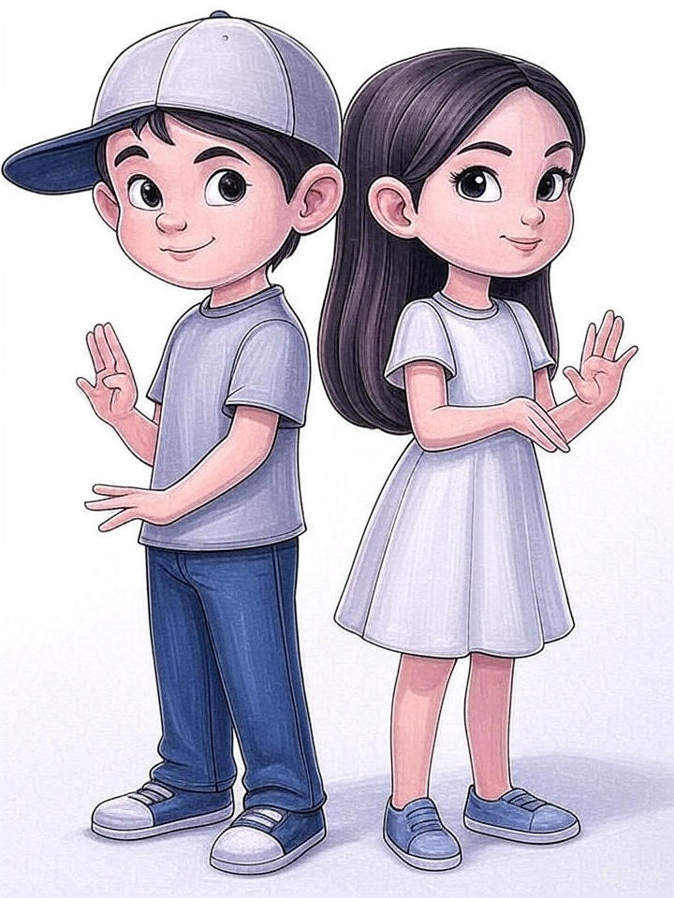
Why stay away from Etomidate and other drugs?—Countless reasons...
After losing consciousness, risk of sexual assault or theft
Permanent physical damage, could lead to death
When confused or muddled, it’s easy to get injured
Buying drugs = providing money to criminals
Physical condition deteriorates
Dependency on drugs develops as a way to escape difficulties, causing even more problems
After becoming addicted, you spend even more money buying drugs
To earn more money for drug purchases, you may be lured by traffickers to take part in illegal activities
Close friends will distance themselves

Slide 11
After learning this, would you still try?
When the pressure from schoolwork is overwhelming
When friends invite me to try my first drug
When I am driven by curiosity
When I feel bored in my free time
When I feel down
假設吸食「依托咪酯」的後果

Slide 12
Quiz
Why do criminals call Etomidate “Space Oil”?
What symptoms appear after using Etomidate?
Are e-cigarettes legal products?
Is vaping fresh flavored e-cigarette oil/cartridges a healthy behavior?
What is the relationship between e-cigarettes and Etomidate?
Aside from physical harm, what other damages does Etomidate cause?
Criminals use aliases to create a false sense of security.
Convulsions / unconsciousness / skin ulcers / loss of control / zombie-like / death
The import, promotion, manufacture, sale, or commercial possession of e-cigarettes is illegal.
No! Adding fresh/sweet scents makes the drug seem healthy.
E-cigarettes are the main tool for consuming Etomidate.
Please refer to the last slide.

Slide 13
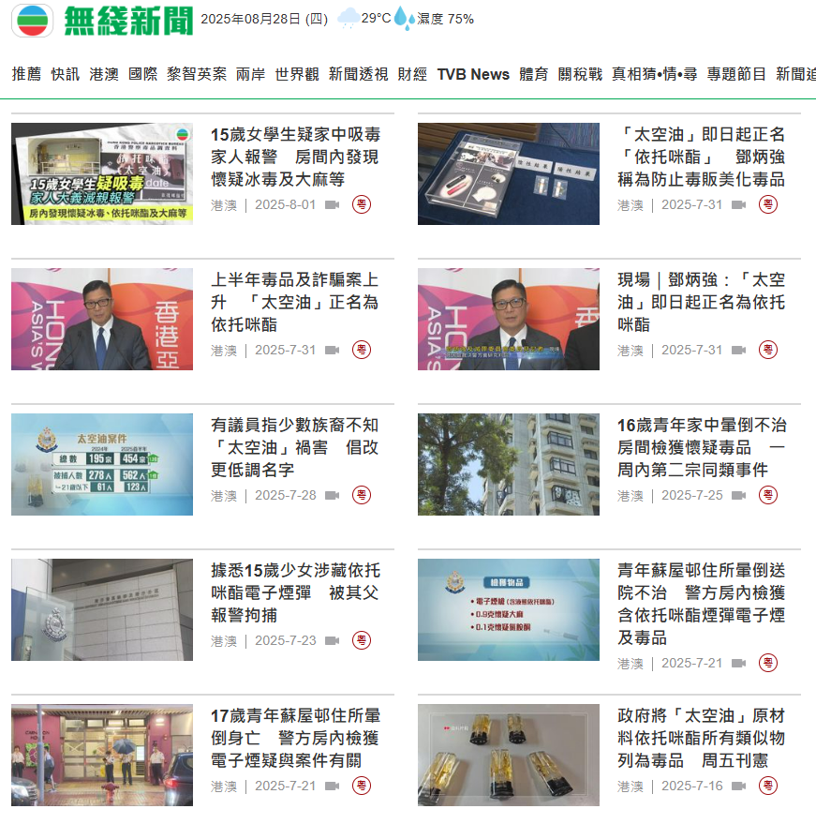
The Reality: Etomidate-Related Cases Are Rising
327 users recorded, a 2.8x increase over the same period last year—over 60% were youth under 21
460 related cases, 561 arrests—a 13x and 9x increase respectively
Seizures jumped from around 7,000 vape cartridges last year to 250,000 this year—a 35x surge

Slide 14
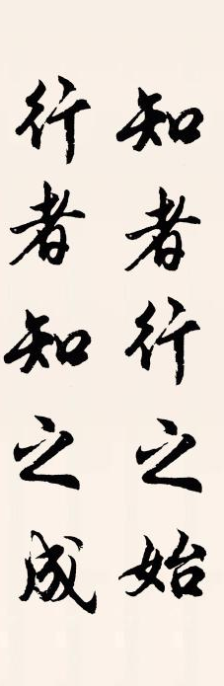
We Must
"Align Knowledge and Action"
Etomidate—everyone knows
Avoiding is wisdom
Image Source:
https://www.70thvictory.com.tw/mingju/bcb357555.htm

Slide 15
Situational Practice: How Would You Refuse?
Scenario 1: Your friend Siu Ming is vaping a regular e-cigarette and invites you to try.
Scenario 2: At a classmate’s birthday party, Ka Ming hands you an e-cigarette with etomidate. Other classmates are vaping too—peer pressure sets in.
Scenario 3: An opposite-sex friend invites you to try "Zombie Oil". You refuse, but the friend says, “Wow, you’re such a coward. How can I even date you?”

Slide 16
The Ten Ultimate Anti-Drug Moves”
Refusal Method 1: Direct—“NO!” “NO！” | Refusal Method 6: Reverse the Situation “Sorry... Let’s not talk about this. I’m short on cash, can you lend me HK$2000? It’s urgent.”
Refusal Method 1: Refuse Strongly. "Don't push me...... I said No!" | Refusal Method 7: Refuse Subtly. “My throat hurts, doctor said not to smoke.”
Refusal Method 3: Knowledge is Power “These are prescription sedatives; misuse will…” | Refusal Method 8: Oppose “We’re good friends, friends don’t harm each other! We’re done!”
Refusal Method 4: Excuse "Sorry, I have to visit my mum who is in hospital now.” | Refusal Method 9: Change the Topic “Etomidate? How do you spell the word?”
Refusal Method 5: End the Conversation “This e-cigarette looks like the pen I saw last time. Let me show you!” | Refusal Method 10: Sages’ Advice “Young people, those things will ruin your future!”
How you refuse isn’t important—knowing how to say no is the key
Notes:
Teaching Tips:
The above content is excerpted from the Department of Health’s Student Health Service website, teaching youth refusal methods for drugs (including drug abuse).
“The Ten Ultimate Anti-Drug Moves” can be used for refusing any harmful drugs.
You can adjust or design teaching activities as needed to help students learn to refuse.
(Example: hold team role-playing contests for creative responses to e-cigarette/drug peer pressure.)
Reference: Student Health Service, Department of Health
https://www.studenthealth.gov.hk/tc_chi/health/health_sdsa/health_sdsa_usa.html

Slide 17
Debunking Myths
No.
Courts generally do not accept “not knowing” as a defence.
Courts repeatedly rule: for trafficking cases—even youth will not get lighter sentences, to prevent drug networks exploiting young people.
Under the strict control of the Dangerous Drugs Ordinance, trafficking or illegal manufacture of such drugs can bring life imprisonment and a HK$5 million fine.
In trafficking cases, is “not knowing” or “being a minor” grounds for leniency?
No.
Etomidate is highly addictive, impacting the brain and causing strong cravings—making it hard to break addiction.
Etomidate is not addictive?
Illegal possession and consumption under the Dangerous Drugs Ordinance carries up to 7 years’ imprisonment and a HK$1 million fine.
Wrong.
Etomidate is a sedative, officially classified as a dangerous drug.
So consuming Etomidate is the same as drug abuse.
Etomidate is just a flavored e-cigarette. When I vape it, I’m not doing drugs, right?

Slide 18
Video: Moon’s Story
16-year-old Moon is a new immigrant.
Heavy schoolwork stresses her.
Few friends, only Ah Heung (also from her hometown) is close.

Slide 19
Moon’s Story – Part 1
Why do young people use Etomidate?
If invited by friends to use Etomidate, how would you respond?

Slide 20
Moon’s Story – Part 2
Does using Etomidate solve Moon’s school pressure?
What health problems does it cause?

Slide 21
Read the article: Out of the Fog—Searching for Freedom (Moon, age 20)
Dangers of Drug Use
Harms body and mind (poor memory, slow reaction, dry skin, acne, hallucinations, irritability, suicidal thoughts);
Wastes money (over HK$10,000 per week, in debt);
Addiction leads to loss of freedom, a dark life; destroys relationships (mixing with bad friends).
Family’s Concern
Family does not blame, but supports patiently;
Called police for help, reflecting deep worry and love;
such unconditional support helps with recovery.
Benefits after quitting drugs
Health recovers (brain function improves, mental stability);
Finances improve (saving, wealth);
Freedom and purpose regained (new friends, job, volunteering activities);
Dreams realized (travel, tattoos), rebuilding a meaningful life.

Slide 22
Out of the Fog—Searching for Freedom—Moon’s Story
Dangers of Drug Use
Why did Moon use Etomidate?
Why does she say addiction was the darkest time of her life?
Family’s Concern
What did Moon’s family do after discovering her drug use?
Why did they call the police?
Benefits after quitting drugs
What are the most obvious changes after Moon’s recovery?
What do you think about “probation being good for Moon”?

Slide 23
Real Case
Etomidate consumption can lead to impaired consciousness or unconsciousness, increasing vulnerability to sexual assault.
In October 2024, a 13-year-old girl reported losing consciousness on three occasions after taking etomidate and being raped by three different men.
Police investigations led to the arrest of the perpetrators.

Slide 24
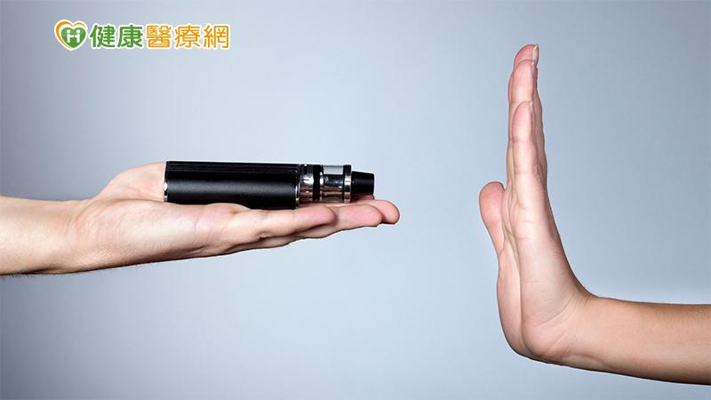
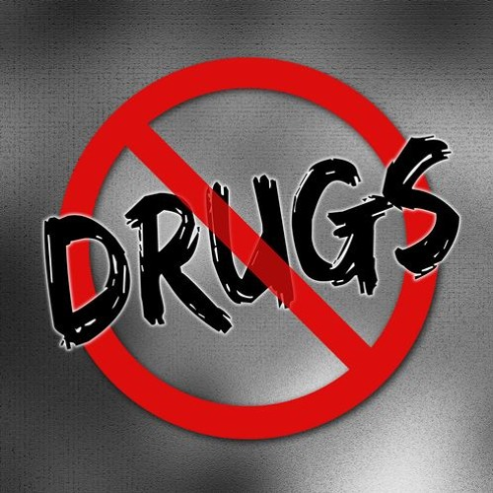


Summary
Etomidate—everyone knows
Avoiding is wisdom
Etomidate e-cigarettes are all drug-related
Appealing drug nicknames make you think there’s nothing to fear
“The Ten Refusal Moves”
How you refuse isn’t important—knowing how to say no is the key
“Not knowing” or “being a minor” are not valid mitigation arguments

