Slide 1


Teaching Topic:
Fraud and Money Laundering

Slide 2


Question Navigation
scenario
If your best friend asks you to borrow a bank account, claiming that it is just a favour to help him collect a sum of money for his business.
He will return the bank account to you and give you $1,000 as a thank you.
Is it a crime to do such a favour?
Is it an offence to do a simple favour without participating in any scheme?

Slide 3


Common misconceptions:
‘It's not a crime if you don't actively participate’ and ‘It's righteous to help your friends’.
Many teenagers think that as long as they are not planning a scam or cheating someone themselves, but only passively providing the tools (bank account), they do not need to be legally liable.
Core element of money laundering:
‘dealing with the proceeds of crime’, whether or not you know the exact source of the money.

Slide 4




Play the Video
Why did Mr. Bad Luck agree to lend his account?
Does it make sense for Mr. Quick Cash to say ‘you don't have to do anything to get paid’?
Why do you think Mr. Bad Luck was eventually arrested by the police?

Slide 5
Play the Video
What is the penalty for participating in money laundering?
Can Mr. Bad Luck get away with his offence or have his sentence reduced on the ground that he had no knowledge of the offence?

Slide 6




The Ending
Mr. Bad Luck was finally sentenced to 32 months' imprisonment.
The judge states:
‘Money laundering’ is a serious offence in which the participant assists in the handling and preservation of the proceeds of the illegal activity and attempts to legitimise the proceeds of the crime, thereby indirectly encouraging the illegal activity.
The court will consider this in the light of the amount of money involved, the number of occasions, the time period, the nature of the predicate offence, etc.
The defendant laundered more than $3 million of crime proceeds in a short period, and the fact that the defendant claimed to be unaware of the source of the money did not constitute mitigating circumstances.

Slide 7

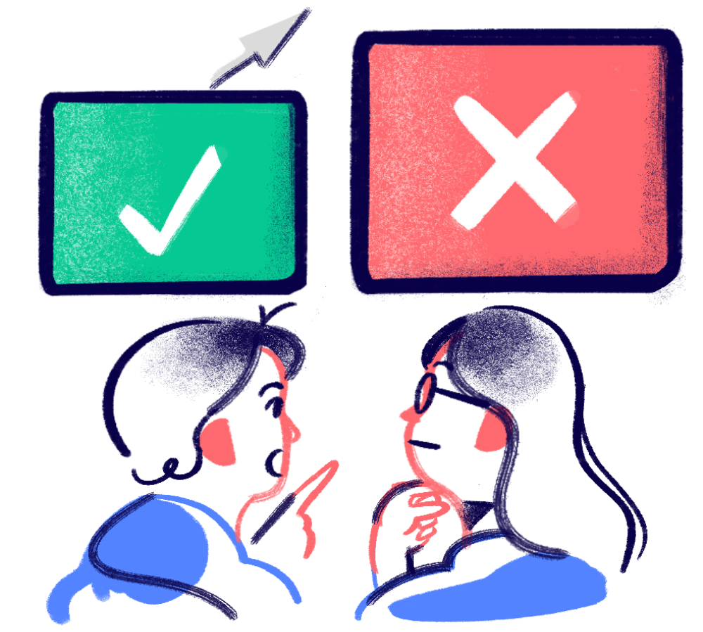

What is ‘Fraud’?
Fraud
Fraud is the intentional act of deceiving someone to gain a benefit, such as money or property, or to cause a loss for another person or institution

Slide 8
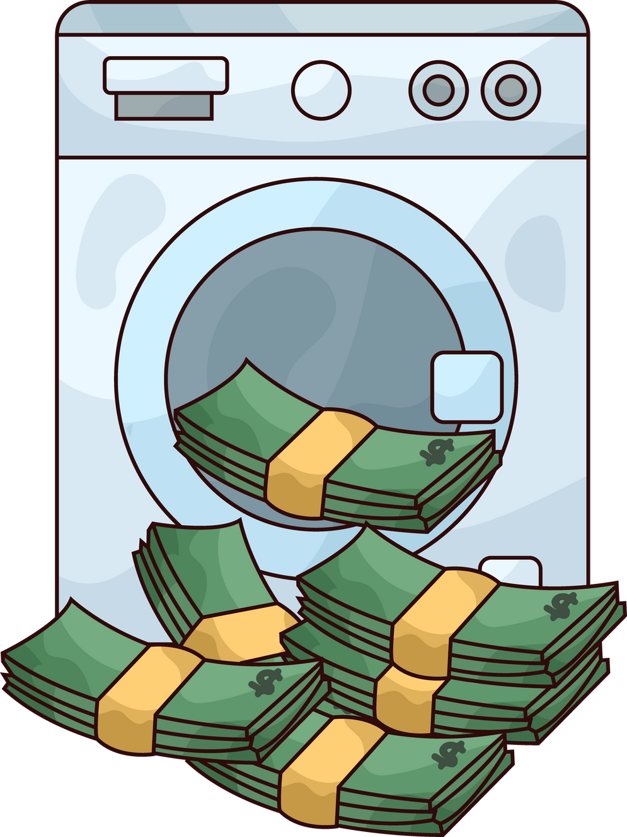
What is ‘Money Laundering’?
Money Laundering
The process of disguising the illicit origin of funds obtained through criminal or illegal activities through a series of complex financial transactions and operations to make the funds appear to be legally obtained

Slide 9

Trend
In 2024, the police arrested 585 young people
aged 10-20 for fraud and money laundering offences. This is 110 fewer than in 2023, a drop of 15.8%.
Despite the drop in arrests,
Fraud is still the main type of juvenile offence accounting for around 20% of all juvenile arrests.

Slide 10

Knowing right from wrong!
Does claiming ignorance equate to innocence?
The person is only doing a favour to a friend and
the degree of involvement is low, so the criminal liability will be lower?
Young people will get a lighter sentence?

Slide 11


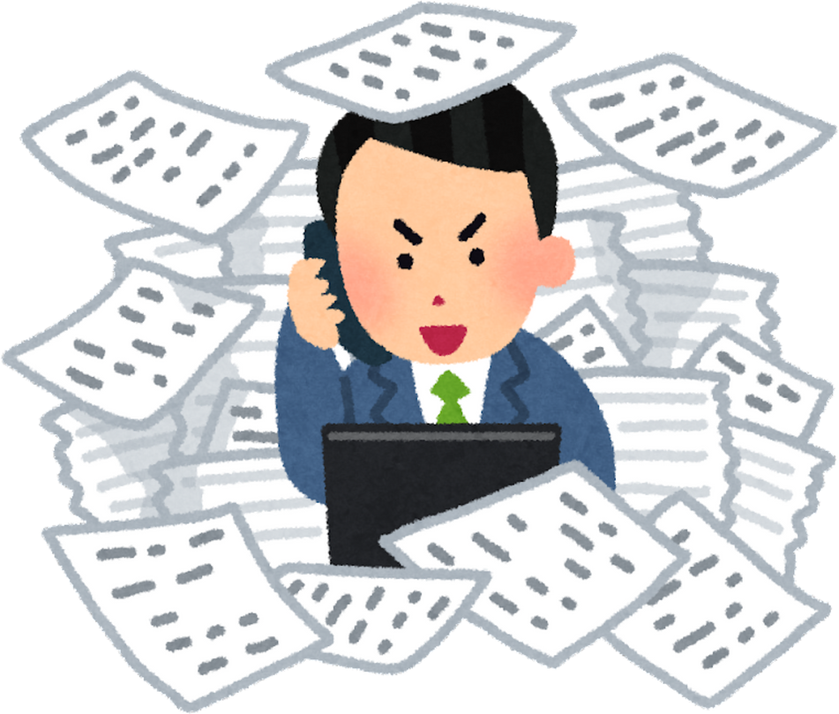

‘The Price’ of Fast Money
Role-playing and Exploration
How did it go?

Slide 12
Small Group Creative Endeavour
Team 1
Students have designed Ah Ho's reaction and reflection in the court.
What do you think he regretted in the end?
Was it the money he received? Or did he lose something more important?
If we rewind the time and go back to the back alley of the restaurant, how could Ah Ho reject the criminals?
Team 2
Team 3
Team 4
Team 5

Slide 13

The Ending
After further investigation, the police prosecuted Ah Hao.
After a court trial, Ah Hao was convicted of one count of ‘conspiracy to defraud’ and sentenced to 50 months' imprisonment.
The judge stated that:
the defendant was part of a conspiracy to defraud and had a role to play alongside the other conspirators;
the defendant was not just an errand boy, but he had an intent to deceive by posing as a friend of the victim's grandchildren and going to the victim's door to collect money from them;
considering the public interest, the court should impose a severe and deterrent sentence, commensurate with the gravity of the offence, in order to deter such offences and to avoid victimisation of innocent members of the public;

Slide 14





Consequences
Legal Consequences
Personal Impact
Emotions and Family
羞恥。
Loss of freedom during imprisonment, separation from family and friends
Chance of being sentenced to imprisonment
A criminal record will be kept for the rest of your life

Slide 15

Crime Prevention Key points
Resolutely reject unlawful behavior.
Seek help in a timely manner.

