Slide 1
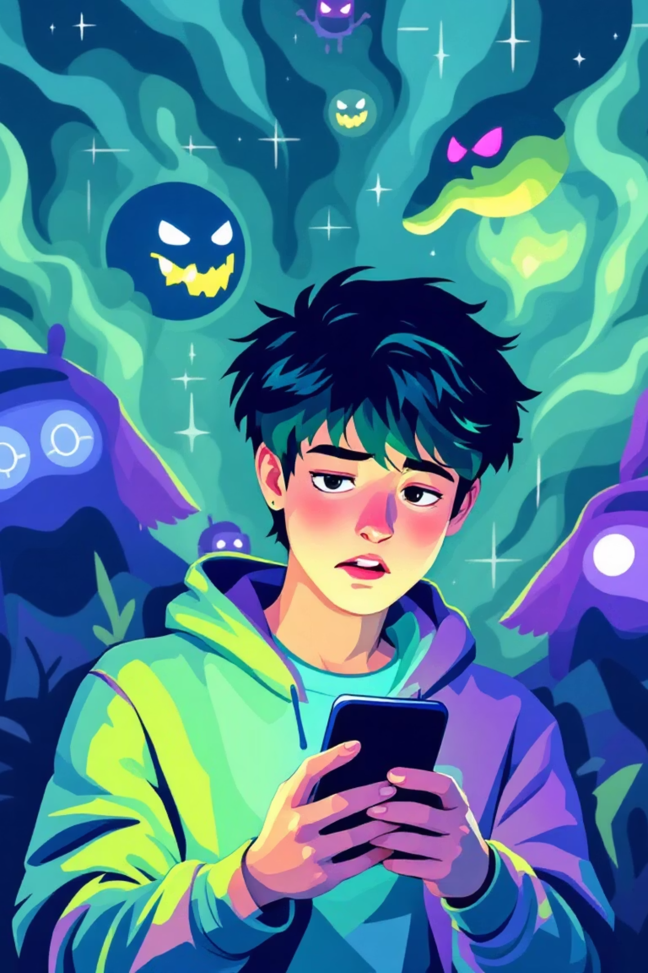
Youth Crime Prevention Booklet
Online Child Sexual Grooming
Illusion of Friendship
Harsh Truth of Eroticism

Slide 2
Objectives
  Understand the definition of online grooming
  Understand related laws
Knowledge
  Reflect on the grave consequences of unlawful actions
  Understand the importance of protecting oneself and respecting others
Emotion
  Establish safe internet usage habits
  Apply effective methods to resist temptation
Action

Slide 3

Before class: Internet Usage Questionnaire
How long do you spend online on average each day?
How many social media accounts do you have?
Have you ever chatted online with strangers?
Have you ever shared personal data online (such as name, gender, age, address, phone number...) with strangers?
Have you ever shared personal photos or videos with online friends?
Have you ever had video chats with online friends?
Have you ever met and dated someone you met online?
Have you ever received messages with sexual implication from online friends that made you feel uncomfortable?

Slide 4

What is Online Grooming？
Offenders approach teenagers through the internet to gain their trust, ultimately committing sexual assault or exerting control.
Providing money/ gift
Emotional manipulation
Use money/ gift as an exchange
Pretending to be friends or lovers to establish false intimacy
Threats and Intimidation
Threaten to release private photos or information for a long-term sexual relationship

Slide 5
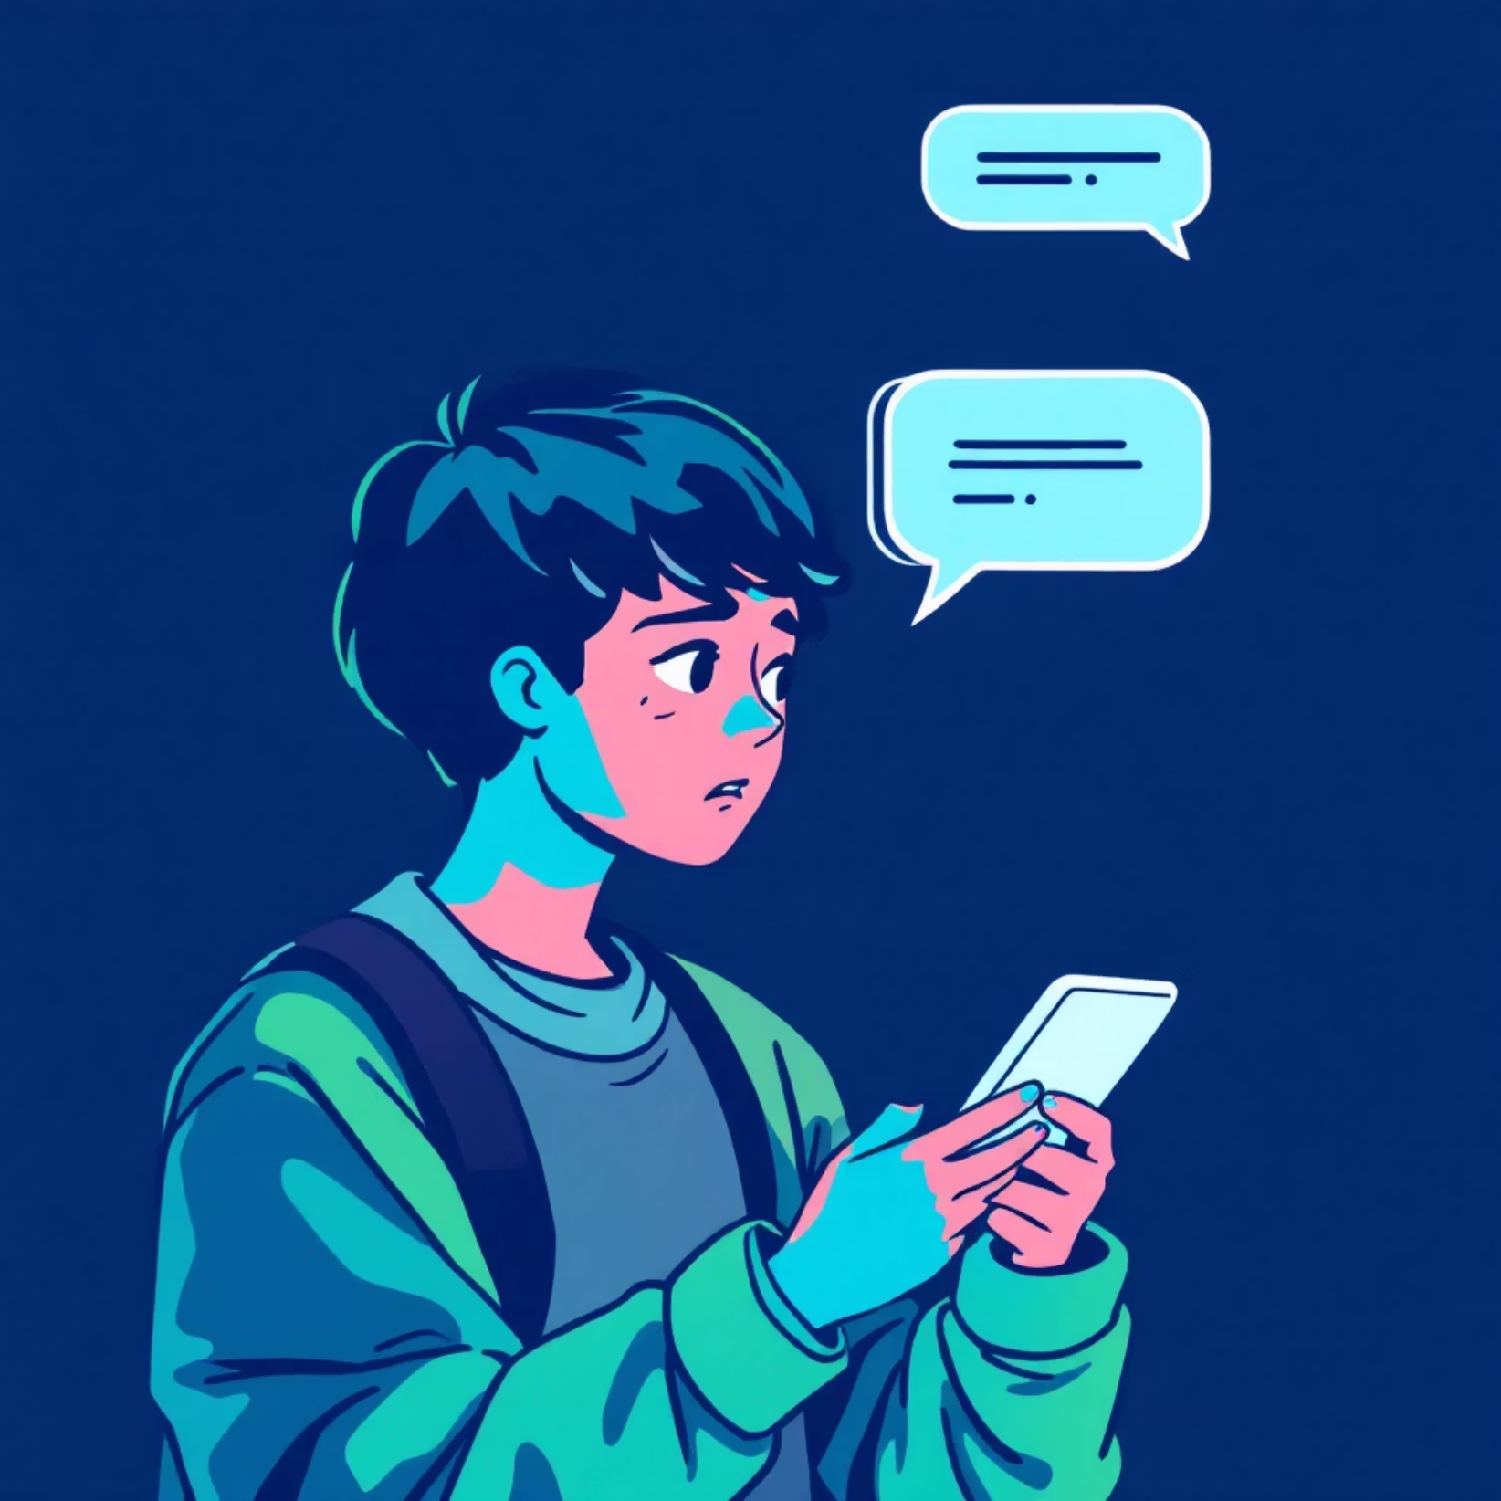
How Online Grooming Occurs？
Messaging Applications
Meet Online ⚠
Social Media Platforms
Online Game Applications

Slide 6

Sing Tao Daily
25/03/2025

Slide 7

Sing Tao Daily
08/04/2025

Slide 8



Video

Slide 9


Yoyo
(Student)
Mr. Smart
(Online friend)

Slide 10


Discussion 1：
How would you respond to your ‘partner's’ request for an intimate photo?
Mr. Smart requested Yoyo to send him a nude photo, Yoyo showed hesitation but still sent one to Mr. Smart…

Slide 11
Discussion 2：
What are the weaknesses of victims that fraudsters will take advantage of to lure them to take nude photos or even meeting each other?
Yoyo entered Mr. Smart’s house and Mr. Smart greeted her happily…

Slide 12





Seduction Signal
Understanding common temptations can help protect yourself
and identify potential dangers.
Eager to establish intimacy
Request for private data or intimate photos
Show excessive enthusiasm and try to quickly develop intimacy or romance
Request you to provide sensitive personal information, home address, phone number, or indecent photos or videos, etc
Provide money or gift as an exchange
Threaten to disclose private messages or photos
Offer money, gifts, or other benefits in exchange for inappropriate behavior or information
Threaten to disclose your private data or indecent photos if you reject their requests

Slide 13

Role-play

Slide 14
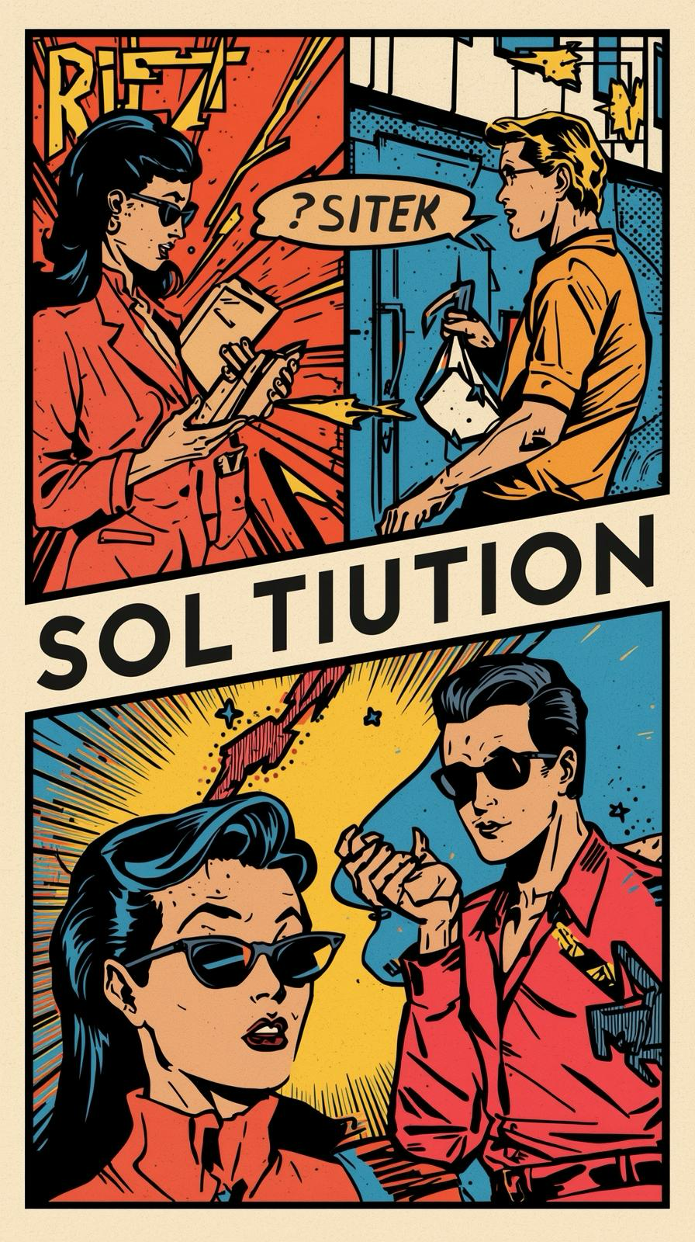




Guidelines
Divide into groups (4-6 people), assign the following roles:
Victim：Play the role of the victim
Deceiver：Play the role of offender
Supporter：Play the role of parent, friend or teach to provide assistance
Observer：Record methods of seduction and how the victim cope with them

Slide 15



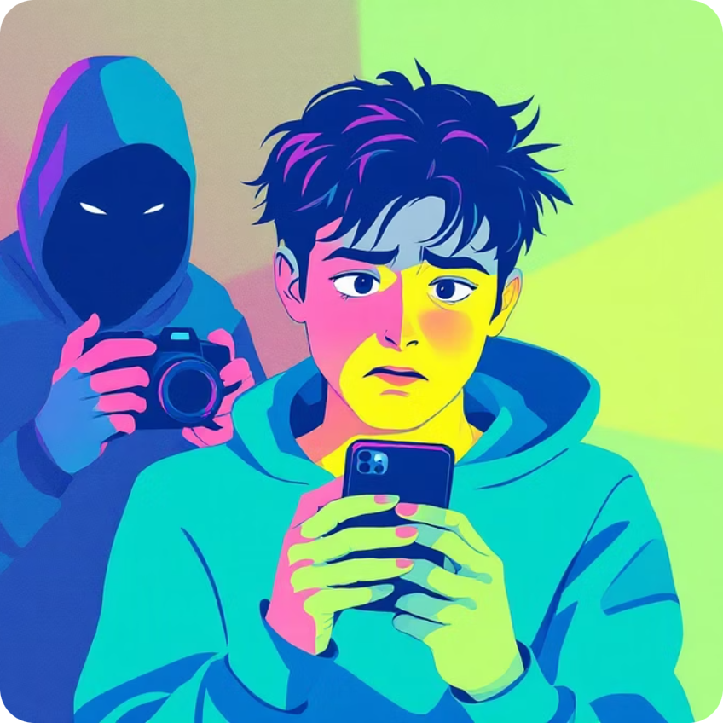
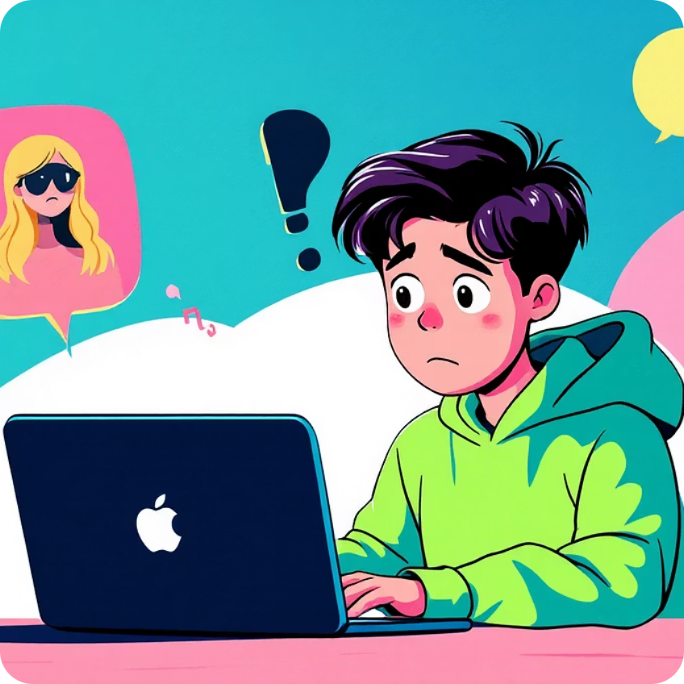
Scenarios
True identity of online friend
The temptation of money
The cost of trust
The threat of indecent images
The test of friendship

Slide 16

Solutions
1
The cost of trust
Instant action: Stop contacting and block the other party, save the chat history as evidence
Emotional support: Relay the situation to a trusted adult and seek counseling
2
The temptation of money
Precaution measures: Reject requests for intimate acts and do not accept money or gifts from online friends
Remedial: ：Relay the situation to a trusted adult and provide police with evidence
3
The test of friendship
Refuse and disconnect: Explicitly reject unreasonable requests, cease contact and block the other party
Emotional support : Talk to your family or counsellor, build healthy friendship

Slide 17

Solutions
4
True identity of online friend
Rule: Never meet online friends alone, especially in unfamiliar places.
If you need to meet someone, tell your family or teacher, choose a public place and go with someone you trust.
Cyber Security: Stay vigilent,, do not easily believe in promises from online friends.
Emotional support: Talk to parent regularly on internet usage to build up a trusting relationship
5
The threat of indecent images
Instant action: Stop contacting and block the other party
Reserve evidence: Save chats and conversation records, screenshots, and threatening content
Seek assistance: Tell a trusted adult and report the case

Slide 18

Myth-busting
1
Consensual sexual intercourse between minors is not an offence?
No! Consent is not a defence. Having consensual intercourse with person under 16 years of age shall be guilty of an offence and liable to imprisonment for 5 years.

Slide 19
Myth-busting
2
I have known my online lover for a long time, he/she is trustworthy.
No！Identity can easily be forged in the online world. Do not trust others easily and do not disclose personal data.

Slide 20
Myth-busting
3
I am just joking with my online friend with no sexual activitiy occurs, it is not illegal.
No！ As long as the behavior involves inducing minors to engage in improper acts (such as sending indecent photos or videos), or threatening, inciting minors to participate in illegal activities, it may already contravene the law.

Slide 21
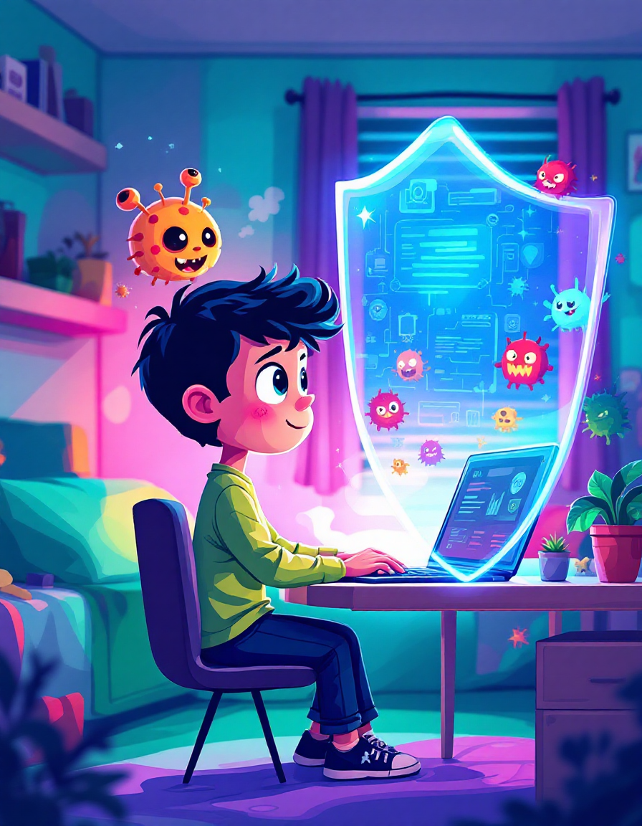
Conclusion
It is normal to have a desire to explore sexuality, but remember that there are somethings you can't share with others!
There's nothing wrong with chatting online, but if the conversation is pornographic or sexual in nature and makes you feel uncomfortable, stop it immediately!
Protect yourself, don't expose yourself in front of the camera or meet online friends alone!

Slide 22

A letter to my future self
Write a letter based on the template, reflecting your habits and coping strategies
Collect the letters and place them in a time capsule
Reopen the time capsule at the end of the semester, examine whether you had put into practice the reminders in the letter
Pick a sentence from the letter and write it on the Cyber Security Pledge Wall as a reminder to yourself and others

