Slide 1

Theft
Youth Crime Prevention Booklet
(2025 Edition)
Photo source：https://depositphotos.com/cn/vector/pickpocketing-flat-color-vector-faceless-character-street-burglar-stealing-wallet-pickpocket-robbing-distracted-woman-thief-347122856.html

Slide 2

Trend of juvenile theft
Theft is one of the most common criminal offences committed by young people, especially shop theft.
The number of juvenile theft cases has been on the rise in recent years. In 2024, a total of 493 juveniles aged between 10 and 20 were arrested for theft, representing an increase of 82 juveniles or 20% when compared with the number in 2023.
Photo source：https://88icon.com/sucai/ippvvlv.html

Slide 3

Activity 1：
If you are …
Photo source：https://zh.pngtree.com/freepng/people-s-police-hand-drawn-cartoon-pattern_4493221.html
Divide into group.
Complete worksheet 1 after discussion.
Teacher will ask students to share the result.

Slide 4

Case 1:
If you are a discipline teacher
Siu Man was playing basketball in the school's basketball court and left his wallet on a bench. Siu Ming saw the wallet and took $30 from the wallet to buy snacks. Two days later, a teacher found out Siu Ming's behaviour by checking the CCTV. Siu Ming denied it at first but later said that he did it for fun and had forgotten to return the wallet, and that he didn't mean to bully Siu Man, he hoped you won't punish him.
Do you think Siu Ming has committed the offence of theft?
Would you accept Siu Ming's explanation and not follow up his case?
Photo source：https://www.douyin.com/search/%E8%80%81%E5%B8%88%E7%94%BB%E5%83%8F%E6%BC%AB%E7%94%BB%E4%BA%BA%E7%89%A9

Slide 5

Case 2:
If you are a police officer
Photo source：https://zh.pngtree.com/freepng/salute-people-police-hand-drawn-cartoon_4493234.html
The alarm was triggered when Mr Cheung passed by the entrance of the Pak Hong Supermarket, the shopkeeper found that Mr Cheung had taken away a bottle of red wine worth $3,000 from the supermarket. Mr Cheung was reluctant to allow the shopkeeper to check his bag and the shopkeeper called the police. You arrived and found that CCTV captured he had put the red wine directly into his bag. Mr Cheung explained that he just forgot to pay and had no intention of stealing, he asked you not to arrest him.
Do you think Mr. Cheung has committed the offence of theft?
Would you accept Mr. Cheung's explanation and not follow up his case?

Slide 6
Had Siu Ming and Mr Cheung committed the offence of theft?
Under the Theft Ordinance (Cap. 210), the following 4 elements constitute the offence of theft:
Dishonestly
Appropriates (Taking away the property, obtaining the property by any means, and continuing to keep the property)
Property belongings to another
With the intention of permanently depriving the other of it (e.g. intention to treat the thing as his own to dispose of regardless of the other’s rights)
Even if no violence is used, the unlawful taking of property with the intention of not returning it constitutes the offence of theft.

Slide 7

Had Siu Ming committed the offence of theft?
Dishonestly | Appropriates | Property belonging to another | Permanently depriving the other of it
Claimed to have fun Refused to admit it | Took away $30 | The $30 belongs to Siu Man | Yes, already used the money to buy snack
30 dollars is not much, it can’t be stealing!
It happened at school and no one would know about it!
Regardless of the value of the items stolen and the offence place, it still constitutes the offence of theft.
Photo source：https://zh.freepik.com/premium%E7%9F%A2%E9%87%8F/cute-kids-ask-question-illustration_154093895.htm

Slide 8

Had Mr Cheung committed the offence of theft?
Dishonestly | Appropriates | Property belonging to another | Permanently depriving the other of it
Claimed that he forgot to pay | Put the red wine directly into his bag | The red wine belongs to the supermarket | Yes, he was not planning to return it
I will just pay it back!
Forgot to pay is not an absolute defence!
Photo source：https://store.line.me/stickershop/product/5059029/zh-Hant

Slide 9

Activity 2：
Video analysis
Photo source：https://zh.pngtree.com/freepng/salute-people-police-hand-drawn-cartoon_4493234.html

Slide 10

Please consider the following questions:
Why did Timid accept what Seedy stole?
Why did Timid engage in the act of stealing?
According to the definition of theft that we had learnt earlier, did Timid commit the offence of theft if she argued that she did not take part in the theft?
Photo source：https://www.tongpsy.com/article_detail.php?id=102

Slide 11
Please consider the following questions:
Why did Timid accept what Seedy stole?
Why did Timid engage in the act of stealing?
Peer pressure
Impromptu
Imprudent

Slide 12
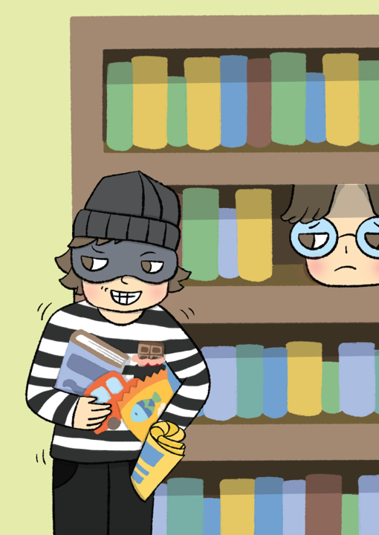
Caution!
Acting as ‘lookout’ also commit a crime!
Acting as ‘lookout’ is equivalent to assisting another person to commit an act of theft.
Both the mastermind and the participants are criminally liable.
圖片來源：https://issuu.com/heephong/docs/storybook17_20221116_ebook

Slide 13
Activity 3：
Quiz on Police Superintendent’s Discretion Scheme (PSDS)

Slide 14

Is it correct that minors who commit offences are not subject to criminal prosecution, and that is more likely that PSDS will be exercised?
Question | Answer
PSDS is the exercise of discretion by a police superintendent or above to administer a caution to arrested juveniles under 18 years old involved in minor offenses as an alternative to criminal prosecution. | Y／N
Juvenile offender must be discharged by way of PSDS if he/she voluntarily admits the offence. | Y／N
Juvenile offender must be discharged by way of PSDS must accept the supervision of Police. | Y／N
Juvenile offender with previous record might be prosecuted. | Y／N
The minimum period of supervision under PSDS is two years. | Y／N
Photo source：https://ixintu.com/sucai/0ikaPjUgk.html

Slide 15
Is it correct that minors who commit offences are not subject to criminal prosecution, and that is more likely that PSDS will be exercised?
Of course NOT!!!
Question | Answer
PSDS is the exercise of discretion by a police superintendent or above to administer a caution to arrested juveniles under 18 years old involved in minor offenses as an alternative to criminal prosecution. | Y／N
Juvenile offender must be discharged by way of PSDS if he/she voluntarily admits the offence. | Y／N
Juvenile offender must be discharged by way of PSDS must accept the supervision of Police. | Y／N
Juvenile offender with previous record might be prosecuted. | Y／N
The minimum period of supervision under PSDS is two years. | Y／N

Slide 16

Police Superintendent’s Discretion Scheme (PSDS)
Under relevant criteria, a police superintendent or above exercises discretion to administer a caution to juvenile offenders under 18 years old involved in minor offenses as an alternative to criminal prosecution, with a view to providing correctional guidance, giving young offenders an opportunity to reform.
The subject must accept the supervision of Police for two years from the date of caution or until the offender's 18th birthday, whichever is earlier.
Photo source：https://www.shutterstock.com/zh/image-vector/illustration-baby-girl-growing-showing-milestones-2614422111

Slide 17

Police Superintendent’s Discretion Scheme (PSDS)
Photo source：https://depositphotos.com/cn/vector/cute-police-character-vector-design-521218138.html
Criteria to be Considered:
the evidence available is sufficient to support a prosecution;
the offender voluntarily and unequivocally admits the offence;
the offender and his/her parents or guardians agree to the cautioning;
the nature, seriousness and prevalence of the offence;
the offender's previous record; and
the attitude of the complainant.

Slide 18

Remember! Juveniles can also be prosecuted!
Photo source：https://zh.pngtree.com/freepng/salute-people-police-hand-drawn-cartoon_4493234.html
In May 2024, a 16-year-old Form 2 boy stole a tablet computer from the victim's school bag at a basketball court in Sha Tin. The Police arrested the boy after detailed investigation.
Further investigation revealed that the boy was also involved in another shop theft case. The Police combined the two cases and prosecuted the boy, who later pleaded guilty to two counts of theft and was subsequently sentenced to rehabilitation centre.
Juvenile offenders also face serious consequences!
What goes around comes around.

Slide 19
Peer pressure
Random act
Imprudent
Impromptu
Worth it?
Loss of freedom
Criminal liability
Serious consequences
Other’s disappointment

Slide 20

Conclusion
Definition of Theft
Permanently depriving the other of it
There is no absolute defence for theft
Police will investigate the intention of the offender
‘Forget to return’ or ‘forget to pay’ is not an absolute defence
Being an accomplice also breaks the law
Participants also have criminal liability
Beware of peer temptation
It is not necessary to handle juvenile cases by means of PSDS.
Dishonestly appropriates property belonging to another
Photo source：https://www.sohu.com/a/642064952_100166256.
Notes:
０

