Slide 1

Unmasking the Screen: Deconstructing Online Sexual Grooming
Task 1: Self-Check: Social Media Usage
1️⃣ Do I use these platforms？
If you use any of the following social-media or online platforms, put a tick (✓) in the box.
Instagram
Online games
Video platforms（For example：YouTube）
Other:_________________
2️⃣ Which platforms do I use most often?
Write down the three platforms that you use most often.
🥇Most used: __________________
🥈2nd most used: __________________
🥉3rd most used: __________________

Slide 2


Unmasking the Screen: Deconstructing Online Sexual Grooming
3️⃣ Have I encountered suspicious situations?
When using social media or online platforms, have you ever experienced any of the following? Please place a tick "✓" in the box.
Received messages from strangers
Strangers reached out wanting to be friends with you
Experienced a situation that felt strange or uncomfortable
None of the above
2

Slide 3

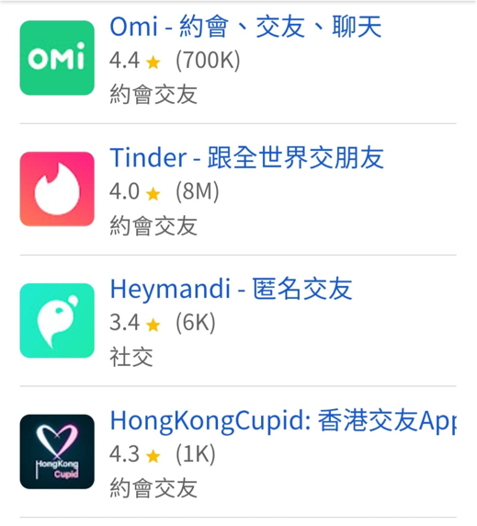
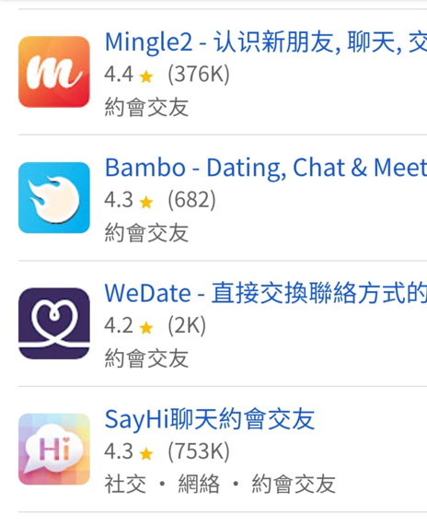

Unmasking the Screen: Deconstructing Online Sexual Grooming
Dating Apps – Traps Are Everywhere
Thousands of dating apps exist, but how many people offer genuine connection?

Slide 4


Unmasking the Screen: Deconstructing Online Sexual Grooming
Statistics on "Online Child Sexual Grooming" Offences
a

Slide 5
Unmasking the Screen: Deconstructing Online Sexual Grooming
 | Offence Category | 2025 | Jan – Mar 2026
Non-consensual Sexual Offences: 85 cases in 2025 | Unlawful sexual intercourse | 47 | 10
 | Indecent assault | 22 | 6
 | Buggery | 5 | 1
 | Rape | 3 | 0
 | Voyeurism-related offences | 8 | 1
Sexual Offences Enacted for the Protection of Vulnerable Persons | Child pornography-related offences | 8 | 5
 | Indecent conduct towards a child under 16 | 4 | 0
Sexual Offences Enacted to Safeguard Public Morals | Outraging public decency, exposure, and sexual offences committed outside Hong Kong | 3 | 1
 | Total | 100 | 24

Slide 6


Unmasking the Screen: Deconstructing Online Sexual Grooming
Statistics on "Online Child Sexual Grooming" Offences:
All child victims were harmed through social media
In 2025, there were 85 reported non-consensual sexual offences

Slide 7
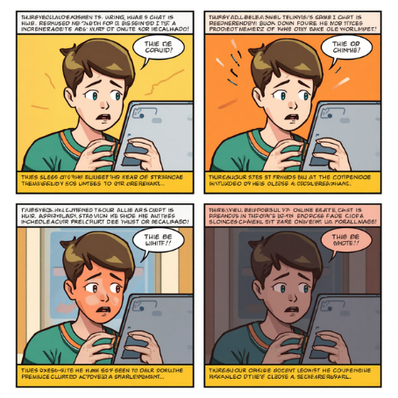
Unmasking the Screen: Deconstructing Online Sexual Grooming
Adapted from a Real Case: Tung and Nam
Watch the video➔
https://youtu.be/ZmWZ-bsFPD4?si=CPqbLCjXDngTjQxZ

Slide 8

Unmasking the Screen: Deconstructing Online Sexual Grooming
Nude Chat Is More Than “Embarrassing”
(Excerpt from：seedfoundation.hk)
Nude chatting can cause deep, long-lasting impacts on a young person's feelings, self-confidence, trust in others, school life, and daily routine.

Slide 9


Unmasking the Screen: Deconstructing Online Sexual Grooming
1. Self-esteem, Body Image and Relationships
Young people who experience nude chatting, are pressured to send nude photos, or have private pictures shared may feel bad about themselves, feel ashamed of their bodies, and find it difficult to trust other people.

Slide 10

Unmasking the Screen: Deconstructing Online Sexual Grooming
2. Worry, Sadness and Self-blame
Young victims may have trouble sleeping, find it hard to concentrate or experience strong changes in mood. Some may even think about hurting themselves.
Some children may blame themselves and think, “It was my fault. I should not have taken that picture.” This can make it harder for them to ask a trusted adult for help.

Slide 11

Unmasking the Screen: Deconstructing Online Sexual Grooming
3. Bullying at school and Long-term Harm
When images are shared among classmates’ groups, a student may face teasing or bullying for a long time. Some may not want to go to school or may need to transfer to another school. Things shared online can be difficult to remove completely.

Slide 12


Unmasking the Screen: Deconstructing Online Sexual Grooming
4. Legal Risks
Even if two young people agree to exchange private pictures, it may still break the law. Other people may also face legal consequences if they download, save, forward or upload these pictures.

Slide 13


Unmasking the Screen: Deconstructing Online Sexual Grooming
Task 2
If a friend or partner asks you to do something that makes you uncomfortable, how would you respond?

Slide 14
Unmasking the Screen: Deconstructing Online Sexual Grooming
I-Message: A Three-step Communication Method
💬Say what happened: “When you ask me to [do something]…”
❤️Say how you feel: “I feel…”
🛑Set a clear boundary: “I would like us to…” / “I do not want to…”
In the video, Nam asks Tung to wear a swimsuit for filming. If you were Tung, what would you say when someone asked you to do something that made you feel uncomfortable or crossed your personal boundaries?

Slide 15

Unmasking the Screen: Deconstructing Online Sexual Grooming
How Can You Protect Yourself When Meeting New People Online or Through Dating Apps?

Slide 16
Unmasking the Screen: Deconstructing Online Sexual Grooming
🎯
If someone gives me gaming credits, are they just being friendly, or could it be the start of a trap?
If I give a gift back of the same value, will that keep me safe?
NO!
🛡️
Some bad people may give small gifts, gaming credits or compliments to make young people feel that they “owe” them something. Later, they may ask for a video call or a selfie. A young person may feel embarrassed to say no and fall into a trap.
Giving a gift back does not always make the situation safe. If someone makes you feel worried, uncomfortable or pressured, stop and ask a trusted adult for help.

Slide 17
Unmasking the Screen: Deconstructing Online Sexual Grooming
When Can You Leave or Seek Help?
Looking for targets
Building trust
Threatening and blackmailing
Isolating the victim
Asking for private images
If someone’s request makes you feel worried, uncomfortable or pressured, you can say no, stop talking to them and ask a trusted adult for help at any time.

Slide 18


Unmasking the Screen: Deconstructing Online Sexual Grooming
Task 3:Three Steps to Stay Safe
Once a picture is sent, you cannot fully control where it goes.
The other person may take a screenshot, share it or use it to threaten you.
Do not believe someone who says, “Only I will see it.”
Protecting your body means protecting yourself
👋Say No to Inappropriate Requests：
Never show private parts of your body on camera or send private pictures to anyone, even someone you are dating.

Slide 19




Unmasking the Screen: Deconstructing Online Sexual Grooming
Task 3:Three Steps to Stay Safe
🔒Protect Your Personal Information：
Do not share personal information with people you meet online, such as your real name, school, home address, telephone number, HKID number or bank-account information
Remember: A real friend will not force you to share your personal information!

Slide 20




Unmasking the Screen: Deconstructing Online Sexual Grooming
Task 3:Three Steps to Stay Safe
🗺️ Make Safe Meeting Plans：
If you meet someone for the first time, meet in a busy public place during the daytime. Travel there and leave on your own. Do not let the person pick you up or take you home. Always keep an eye on your food and drinks.
Make sure that the meeting place is safe. Do not put yourself in danger!

Slide 21

Unmasking the Screen: Deconstructing Online Sexual Grooming
Do You Know Other Ways to Protect Yourself ?

Slide 22

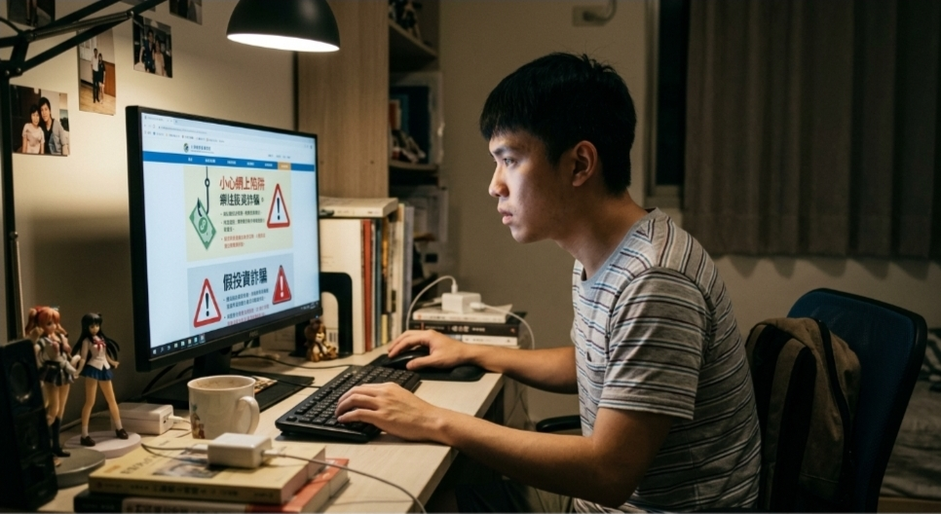
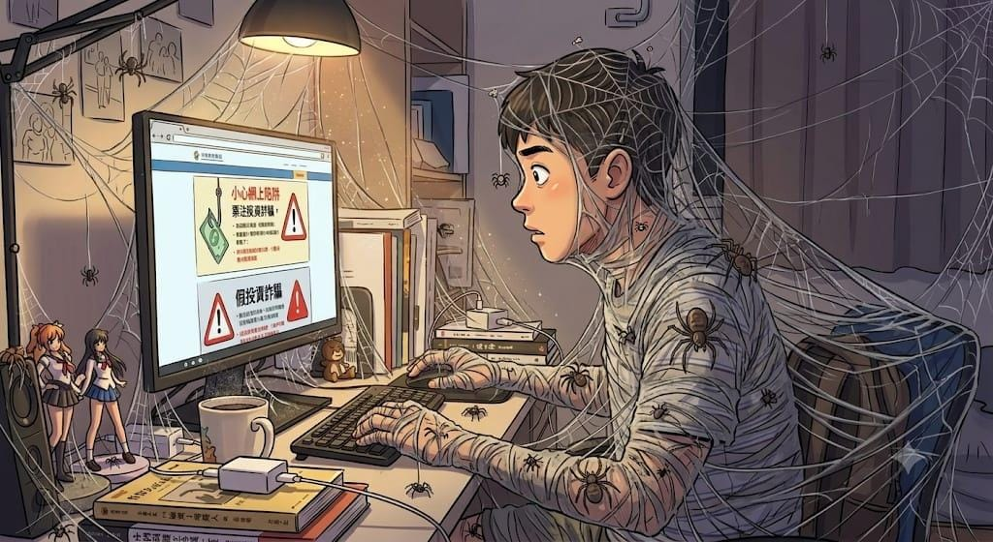

Unmasking the Screen: Deconstructing Online Sexual Grooming

Slide 23


Unmasking the Screen: Deconstructing Online Sexual Grooming
Invisible Traps:
Beware of Online Sexual Grooming
🌐 The online world has many traps. People who want to trick others keep changing their methods, so we must stay alert.
✅Key Takeaways：
• Dating apps and nude-chat traps are everywhere
• Do not make rushed decisions
• Follow the three steps to stay safe: say no to inappropriate requests, protect your personal information, and make safe meeting plans.
💪 Remember: If something seems suspicious, be brave to say “NO”. Ask parents, teachers, or the police for help.
📞 Hong Kong Police Force Anti-Scam Helpline: 18222
23

Slide 24

Unmasking the Screen: Deconstructing Online Sexual Grooming
Special Acknowledgement：

