Slide 1

Unmasking the Screen: Deconstructing Online Sexual Grooming
Task 1: Self-Check: Social Media Usage
Do I use it?
Do you use any of the following social-media platforms or online platforms? If yes, put a「✓」in Column (1).
Which platform do I use most often？
In Column (2), rank the social-media or online platforms that you use most often. Write “1” for the one you use most, “2” for the second most used, and so on.
Have I encountered suspicious situations?
    When using the following social-media or online platforms, have you ever:
    Suspected that you were being scammed or encountered a scam?
    Received a message or friend request from a stranger?
    If either situation has happened, put a tick (✓) in Column (3).

Slide 2

Unmasking the Screen: Deconstructing Online Sexual Grooming
Social Media / Online Platform | （1） I use this 「✓」 | （2） I use it most often 「1、2、3、…」 | （3） I have encountered a suspicious situation「✓」
Instagram
2. Dating Apps
3. WeChat
4. Online Games
5a. Other：
5b. Other：

Slide 3

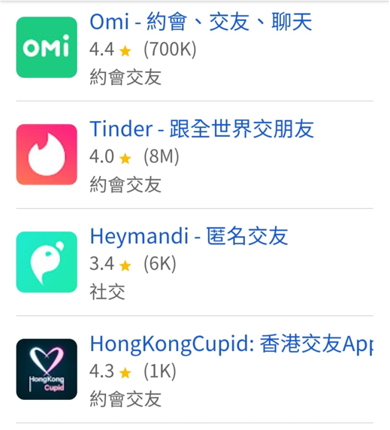
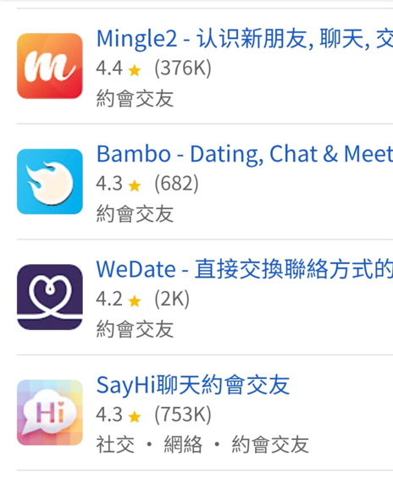

Unmasking the Screen: Deconstructing Online Sexual Grooming
Dating Apps – Traps Are Everywhere
Thousands of dating apps exist, but how many people offer genuine connection?

Slide 4


Unmasking the Screen: Deconstructing Online Sexual Grooming
Statistics on "Online Child Sexual Grooming" Offences
a

Slide 5
Unmasking the Screen: Deconstructing Online Sexual Grooming
 | Offence Category | 2025 | Jan – Mar 2026
Non-consensual Sexual Offences: 85 cases in 2025 | Unlawful sexual intercourse | 47 | 10
 | Indecent assault | 22 | 6
 | Buggery | 5 | 1
 | Rape | 3 | 0
 | Voyeurism-related offences | 8 | 1
Sexual Offences Enacted for the Protection of Vulnerable Persons | Child pornography-related offences | 8 | 5
 | Indecent conduct towards a child under 16 | 4 | 0
Sexual Offences Enacted to Safeguard Public Morals | Outraging public decency, exposure, and sexual offences committed outside Hong Kong | 3 | 1
 | Total | 100 | 24

Slide 6


Unmasking the Screen: Deconstructing Online Sexual Grooming
Statistics on "Online Child Sexual Grooming" Offences:
All child victims were harmed through social media
In 2025, there were 85 reported non-consensual sexual offences

Slide 7
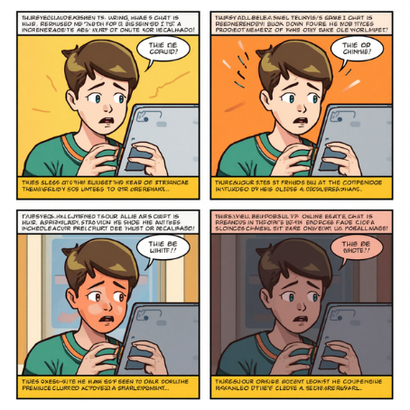
Unmasking the Screen: Deconstructing Online Sexual Grooming
Adapted from a Real Case: Tung and Nam
Watch the video➔
https://youtu.be/ZmWZ-bsFPD4?si=CPqbLCjXDngTjQxZ

Slide 8

Unmasking the Screen: Deconstructing Online Sexual Grooming
Nude Chat Is More Than “Embarrassing”
(Excerpt from：seedfoundation.hk)
Nude chatting, being pressured to send nude photographs, or having private images shared can have serious and lasting effects on young people’s mental well-being, self-image, interpersonal trust, academic life, and daily routine.

Slide 9


Unmasking the Screen: Deconstructing Online Sexual Grooming
1. Self-esteem, Body Image and Relationships
Young people who experience nude chatting, are forced to send nude photographs, or have private images shared may develop low self-esteem, feel ashamed of their bodies, and find it difficult to trust others.

Slide 10

Unmasking the Screen: Deconstructing Online Sexual Grooming
2. Anxiety, Depression and Self-blame
Victimised teenagers may experience insomnia, difficulty concentrating, mood swings, self-harm, or suicide. Crucially, many students blame themselves completely: "I was so stupid, I shouldn't have taken that photo." This guilt stops them from seeking adult help.

Slide 11

Unmasking the Screen: Deconstructing Online Sexual Grooming
3. School Bullying and Long-term Labelling
When images are shared among classmates’ groups, young people may face long-term teasing, ridicule and labelling. Some students may refuse to attend school, transfer to another schools or drop out. Moreover, digital footprints left online are often impossible to erase completely.

Slide 12


Unmasking the Screen: Deconstructing Online Sexual Grooming
4. Legal Risks and Criminal Liability
Even when both people are under 18 and appear to have exchanged intimate images voluntarily, the law may regard this as producing or possessing child pornography. Anyone else who downloads, saves, forwards or uploads such images may also face criminal liability.

Slide 13


Unmasking the Screen: Deconstructing Online Sexual Grooming
Task 2
If a friend or partner asks you to do something that makes you uncomfortable, how would you respond?

Slide 14
Unmasking the Screen: Deconstructing Online Sexual Grooming
I-Message: A Three-step Communication Method
💬State the concrete facts: “When you ask me to [do something]…”
❤️Express your true feelings: “I feel…”
🛑Set a clear boundary: “I would like us to…” / “I do not want to…”
In the video, Nam asks Tung to wear a swimsuit for filming. If you were Tung, how would you respond when someone asks you to do something that makes you uncomfortable or crosses your personal boundaries?

Slide 15

Unmasking the Screen: Deconstructing Online Sexual Grooming
How Can You Protect Yourself When Meeting New People Online or Through Dating Apps?

Slide 16
Unmasking the Screen: Deconstructing Online Sexual Grooming
🎯
If someone gives me gaming credits, is that the beginning of grooming, or simply online etiquette between friends?
If I immediately give them something of equal value in return, will that keep me safe? If we do not owe each other anything, will they have no reason to threaten me?
NO!
🛡️
Offenders use the principle of reciprocity to set traps. They may give small gifts, gaming credits or compliments to make young people feel that they owe them something. This sense of obligation can reduce a student’s alertness.
When the person later asks to start a video call or take a selfie, young people may feel too embarrassed to refuse and fall into the trap.
Sending a gift of equal values does not remove an offender’s harmful intentions. Instead, it may signal that you are an easy target to manipulate.

Slide 17
Unmasking the Screen: Deconstructing Online Sexual Grooming
Looking for targets
Building trust
Threatening and blackmailing
Isolating the victim
Asking for intimate images
When Can You Leave or Seek Help?
Whenever someone’s request makes you feel worried, uncomfortable or pressured, no matter what stage the situation has reached, you have the right to say no, stop contact and seek help from a trusted adult.

Slide 18


Unmasking the Screen: Deconstructing Online Sexual Grooming
Three Steps to Prevent online sexual Grooming
Once an image is sent, you lose control over how it is shared.
The other person may take screenshots, forward it or use it to blackmail you.
Do not believe someone who says, “I will be the only one who sees it.”
Protecting your body means protecting your dignity.
👋Refuse Inappropriate Requests：
Never expose your body online or send intimate images, even to a partner in a “stable relationship.

Slide 19




Unmasking the Screen: Deconstructing Online Sexual Grooming
Three Steps to Prevent online sexual Grooming
🔒Protect Your Personal Privacy：
Do not share real personal information with people you meet online, including your real name, school, home address, telephone number, Hong Kong Identity Card number or bank-account information.
Remember: A real friend will not pressure you to provide personal information!

Slide 20




Unmasking the Screen: Deconstructing Online Sexual Grooming
Three Steps to Prevent online sexual Grooming
🗺️ Take Control of the Situation：
If you meet someone for the first time, choose a busy public place during the daytime. Travel there and leave on your own. Do not let the person pick you up or take you home, and never leave your food and drinks unattended.
Make sure that the meeting place is safe. Do not put yourself in danger!

Slide 21

Unmasking the Screen: Deconstructing Online Sexual Grooming
Do You Know Other Ways to Protect Yourself ?

Slide 22

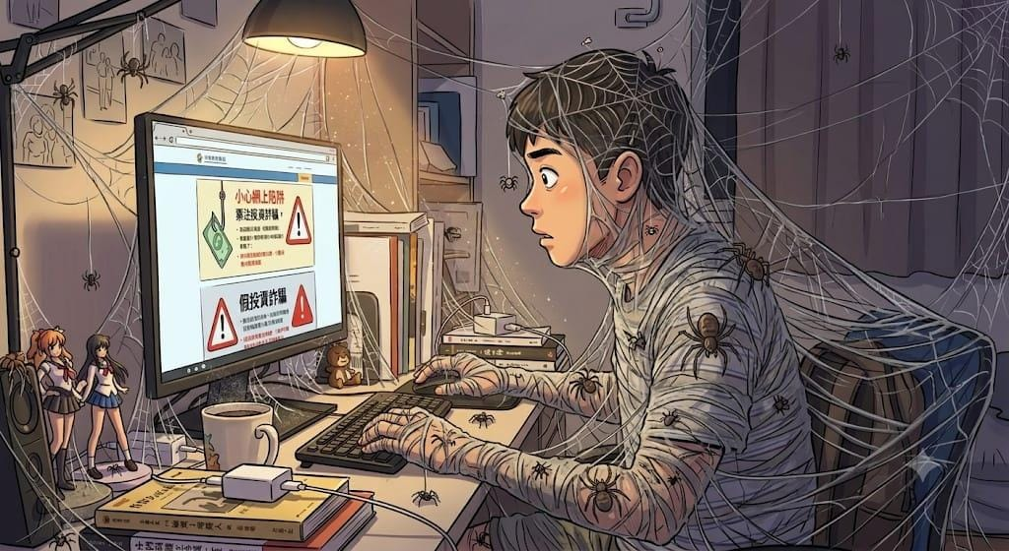
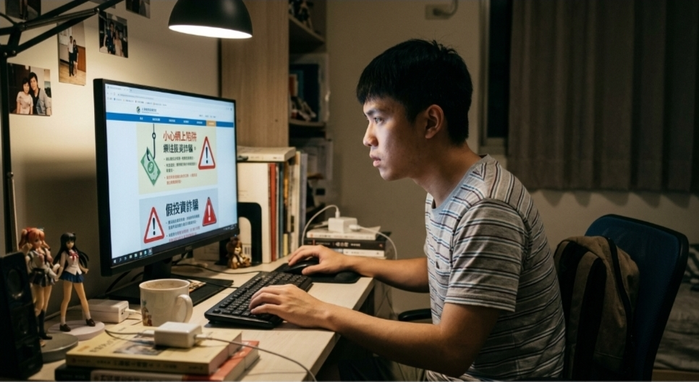

Unmasking the Screen: Deconstructing Online Sexual Grooming

Slide 23


Unmasking the Screen: Deconstructing Online Sexual Grooming
Invisible Traps:
Beware of Online Sexual Grooming
🌐 The online world contains many traps, and scam techniques are constantly changing.
Stay alert!
✅Key Takeaways：
• Dating apps and nude-chat traps are everywhere
• Never act recklessly
• Follow the three steps to prevent grooming: refuse inappropriate requests, protect your personal privacy, take control of the situation
💪 Remember: If you encounter anything suspicious, be brave to say "NO“, and seek help from parents, teachers, or the Police!
📞 Hong Kong Police Force Anti-Scam Helpline: 18222

Slide 24

Unmasking the Screen: Deconstructing Online Sexual Grooming
Special Acknowledgement：

