Slide 1
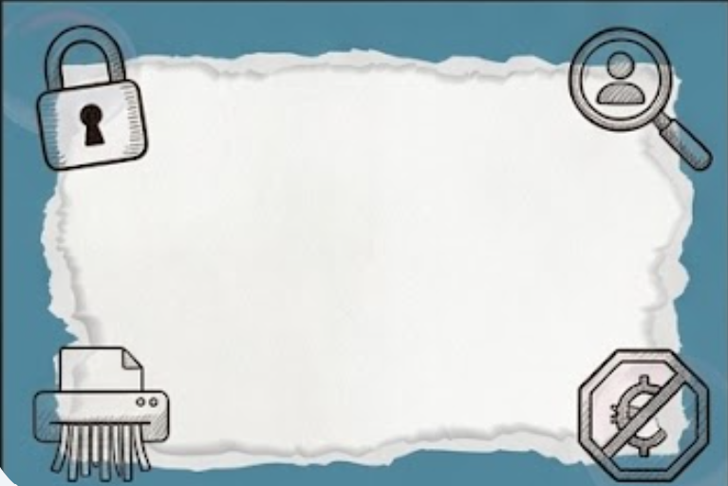
Financial Mindset Quiz
Spotting Quick Cash Traps: Say No to Temptation
Imagine that a relative gives you a red packet containing HK$100. What would you do with it?
Save all
Spend all
Half and half
1

Slide 2

Option A: The Saving Master💰
Spotting Quick Cash Traps: Say No to Temptation
Core Idea: Feels that putting money into a piggy bank or bank account is the safest thing to do.
Money Attitude: Believes in "every little bit adds up" and avoids spending money recklessly.
Friendly Reminder: Saving money is a wonderful habit! However, it is also completely fine to occasionally spend some money on useful learning tools or share some treats to enjoy happy moments with your friends.
2

Slide 3
Option B: The Instant Joy-Seeker🎉
Spotting Quick Cash Traps: Say No to Temptation
Core Idea: Feels that the true purpose of money is to buy happiness and get things they like right away.
Money Attitude: Spends whenever they want to, prioritizing immediate satisfaction and fun.
Friendly Reminder: Although it feels super exciting at the moment, if you spend all your money at once, you might not have enough left when you really need to buy important things or face an unexpected emergency!
3

Slide 4
Option C: The Smart Money Manager ⚖️
Spotting Quick Cash Traps: Say No to Temptation
Core Idea: Believes in the healthy balance of "saving a portion while spending a portion.“
Money Attitude: Divides money into two parts—one half is tucked away safely into savings, and the other half is used to buy things they need.
Friendly Reminder: This is an excellent budgeting habit! It keeps your future protected while allowing you to enjoy small rewards in the present.
4

Slide 5
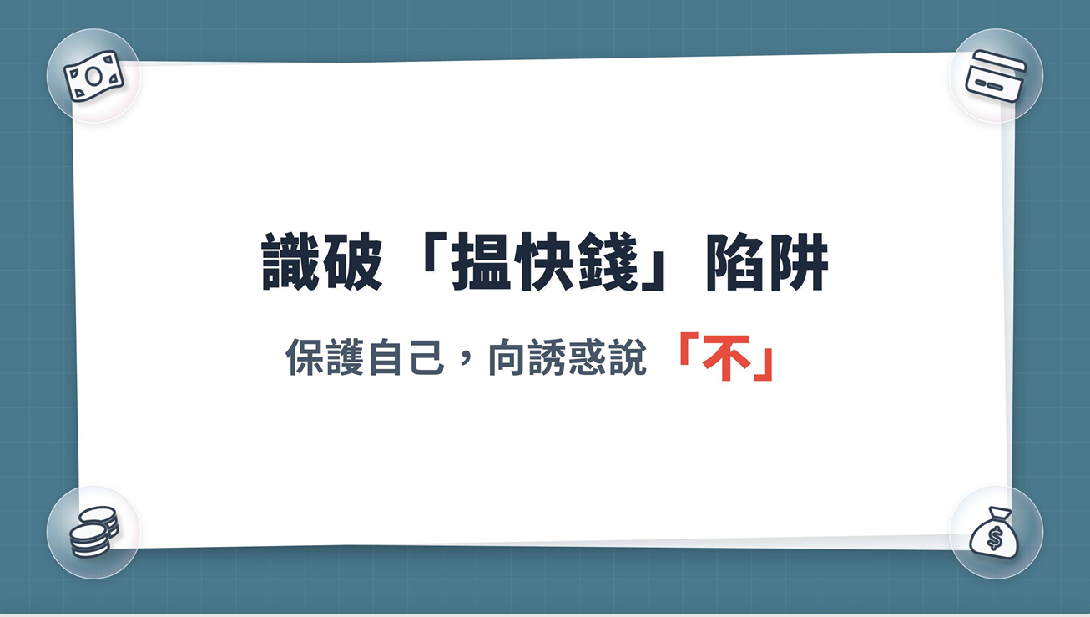
Spotting Quick Cash Traps: Say No to Temptation
Spotting Quick Cash Traps:
Say No to Temptation
5

Slide 6

Loss Comes First, Gains Never Arrive
《識破「搵快錢」陷阱：向誘惑說「不」》
Watch the video
https://youtu.be/zMWuC2SbB3U?si=mzsbHWu8Q2X2dP_Y
6

Slide 7
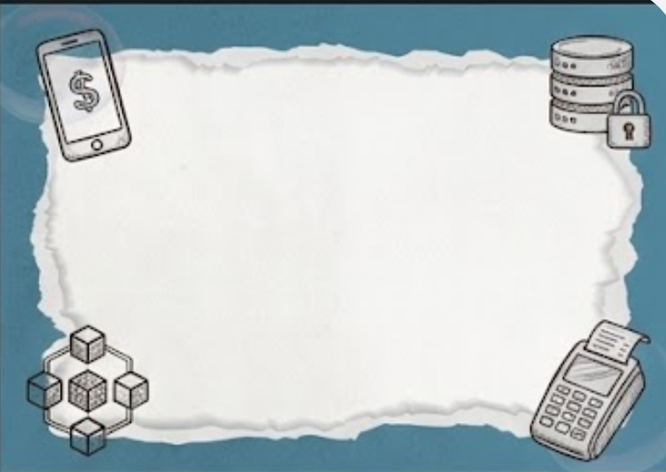


Does a“high-paying, low-effort” job really exist?？
Spotting Quick Cash Traps: Say No to Temptation
What might be the hidden cost behind these jobs?
7

Slide 8

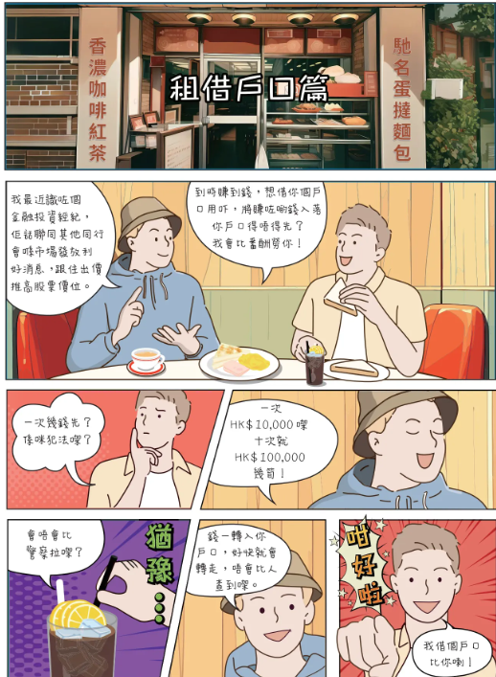
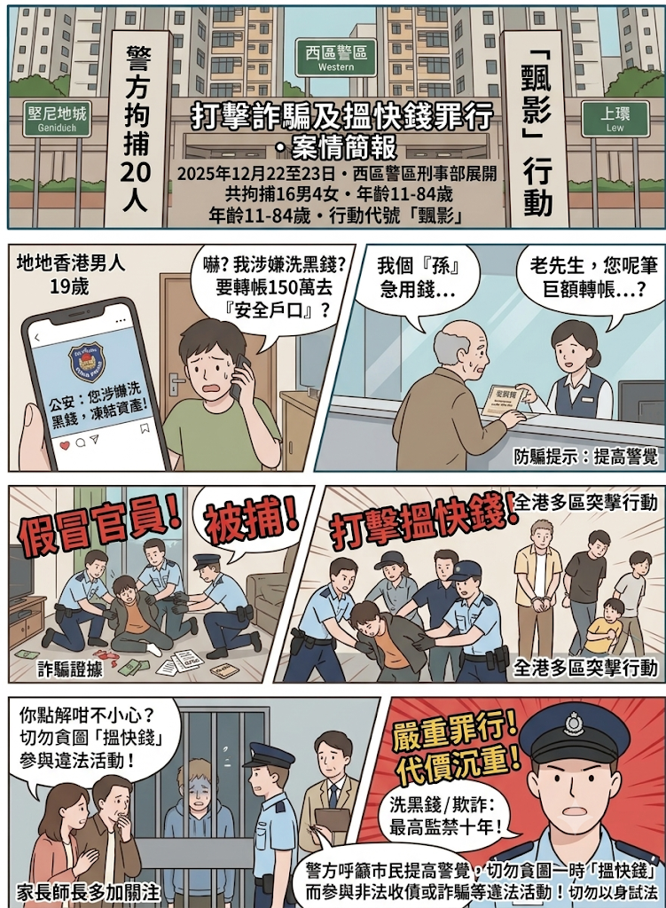
《識破「搵快錢」陷阱：向誘惑說「不」》
Cases
study
8
https://www.police.gov.hk/info/ebook/fiib/2024/01/index.html#p=5

Slide 9

Spotting Quick Cash Traps: Say No to Temptation
"I was just helping to collect money / open a bank account / run errands.
I was not the person who cheated anyone, so the punishment should not be very serious, right?”
Do you agree？
9
https://www.police.gov.hk/info/ebook/fiib/2024/01/index.html#p=5

Slide 10
Legal Consequence
Spotting Quick Cash Traps: Say No to Temptation
Theft: The maximum penalty is 10 years’ imprisonment.
Fraud: Upon conviction, the maximum penalty is 14 years’ imprisonment.
Money laundering: Lending accounts or handling illicit proceeds carries a maximum fine of HK$5,000,000 and 14 years imprisonment.
10
10

Slide 11
The Heavy Price of Making the Wrong Choice
Spotting Quick Cash Traps: Say No to Temptation
Legal Responsibility: Regardless of age, helping criminals collect money, deliver packages or disclose personal information may lead to arrest and juvenile detention.
Family Distress: Involvement in illegal activities can cause loved ones deep distress, worry and helplessness.
Loss of Freedom and Opportunities: A criminal record may restrict travel and overseas study and make employment more difficult.
11

Slide 12
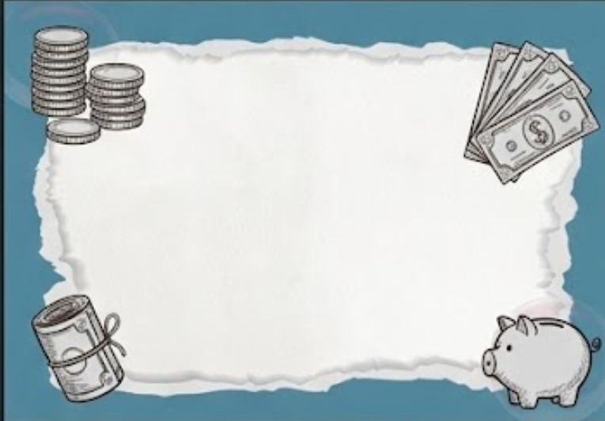
Scenario 1:
Spotting Quick Cash Traps: Say No to Temptation
  While playing games online, a stranger says: "Help me download this app to register an account, or give me your phone number/your mom's verification password, and I'll gift you a full set game tokens.“
  Reflection: This is exactly the same dangerous behavior as "selling out personal data/bank accounts" in the secondary school syllabus. It puts both the child and their family at risk of fraud or committing a crime.
12

Slide 13
Scenario 2:
Spotting Quick Cash Traps: Say No to Temptation
A "cool older brother" met online says: "Help me pass this bag to someone/go to the convenience store to buy a few gaming point cards for me, and I'll buy you hamburger or give you $50."
Reflection: There is no such thing as a free lunch. Carrying packages or running errands for strangers can easily involve illegal items (like stolen goods or contraband), and children will still face severe consequences.
13
13

Slide 14
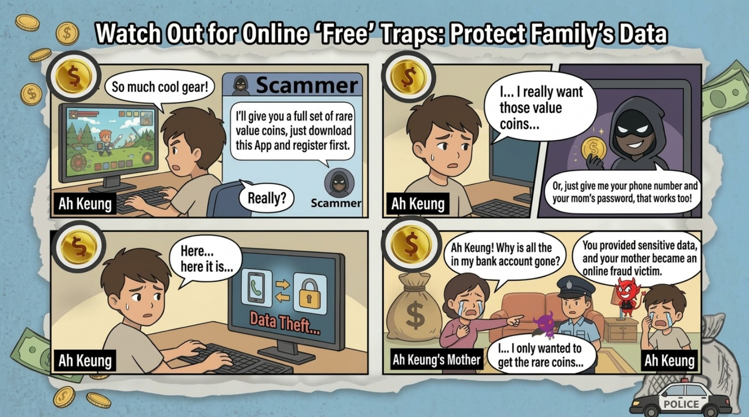
14

Slide 15

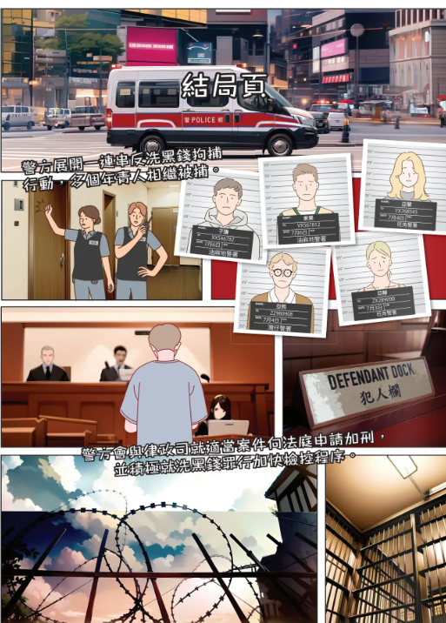
This is not just a financial scam.
It can destroy victims’ families, sense of security, and their future.
Spotting Quick Cash Traps: Say No to Temptation
15
https://www.police.gov.hk/info/ebook/fiib/2024/01/index.html#p=14

Slide 16
Spotting Quick Cash Traps: Say No to Temptation
Spot the Scam! 5 Big Warning Signs 🛑：
Mysterious Rewards 🎁: Someone promises to give you expensive game skins, gift cards, or lots of cash for doing almost no work at all.
Demanding Secrecy 🤫: The person strictly tells you, "You must keep this a secret and never tell your parents or teachers."
Strange Tasks 📦: You are asked to deliver a mysterious package without knowing what is inside, or to go to a convenience store to buy a huge amount of gaming point cards.
Asking for Private Passwords 🔑: Someone asks for your family’s credit card numbers, phone verification codes, or personal account passwords.
Unfair Exchanges ⚠️: You are asked to give away your phone number, a photo of your student ID, or your personal account details just to get a small favor.
16

Slide 17
The 3 Safety Steps
Spotting Quick Cash Traps: Say No to Temptation
Stop:
If a stranger online or offline asks for money, passwords, or asks you to do a "secret task," stop immediately!
Think:
Think to yourself: "Is this too good to be true?" or "Why is this person asking me to keep a secret?“
Report:
Immediately tell your parents, a teacher, or a trusted adult. Do not try to handle it or investigate it yourself.
17

Slide 18

Anti-scam Video
Spotting Quick Cash Traps: Say No to Temptation
https://www.youtube.com/watch?v=aG9_Z3b9ddI
18

Slide 19

Spotting Quick Cash Traps: Say No to Temptation
Special Acknowledgement：
18

