Slide 1

Financial Mindset Quiz
Spotting Quick Cash Traps: Say No to Temptation
If you had $2,000 in lucky money (Lai See), how would you handle it?
A. Save all of it for future use.
AB. Save half and use the other half to buy something you love.
B. Spend it all right away on eating, drinking, and having fun, treating friends, and showing off!
1

Slide 2


Personality traits:
《識破「搵快錢」陷阱：向誘惑說「不」》
🏆 If you chose 🅰️:
Your mindset is very healthy. You clearly know the difference between "needs" and "wants," which will protect you from falling into most financial traps and money laundering scams.
⚖️ If you chose 🆎:
You might make an impulse purchase from time to time, but you are generally able to hit the brakes and control your spending before it is too late.
⚠️ If you chose 🅱️:
You might fear being left out. You tend to seek security by chasing after "things that everyone else has." This often comes from an urgency to prove yourself or a feeling of envy toward other people's glamorous lifestyles.
2

Slide 3
Option A: The Cautious Saver💰
(Values security and wealth accumulation)
Spotting Quick Cash Traps: Say No to Temptation
Core mindset:
Views money as protection against future risks and places great importance on keeping money safe and building up savings.
View of money:
Tends to delay gratification and believes that small savings can add up over time.
Strengths and weaknesses:
Has a strong sense of financial security and is better prepared for unexpected risks. However, being too cautious may mean missing out on meaningful experiences or social opportunities.
3

Slide 4
Option B: The Live-for-Today Spender🎉
(Values present experiences)
Spotting Quick Cash Traps: Say No to Temptation
• Core mindset:
Believes in “living in the moment” and sees money as a way to create happiness, good memories and relationships.
• Value of money:
Believes that money has value when it is used, with present enjoyment considered more important than future financial security.
• Strengths and weaknesses:
Can enjoy life and social activities fully. However, without an awareness of risk, may face money problems or find it difficult to deal with unexpected situations in the future.
4

Slide 5
Option C: The Balanced Planner⚖️
(Values flexibility and sustainable money management)
Spotting Quick Cash Traps: Say No to Temptation
• Core mindset:
Views money as protection against future risks and places great importance on keeping money safe and building up savings.
• Value of money:
Believes that money should provide security for the future while also improving quality of life in the present. Strike a balance between long-term security and present satisfaction.
• Strengths and weaknesses:
Has good control over their budget and can balance risk and enjoyment. However, their savings may accumulate more slowly than those who saves everything, while they may enjoy fewer immediate pleasures than someone who spends freely.
5

Slide 6
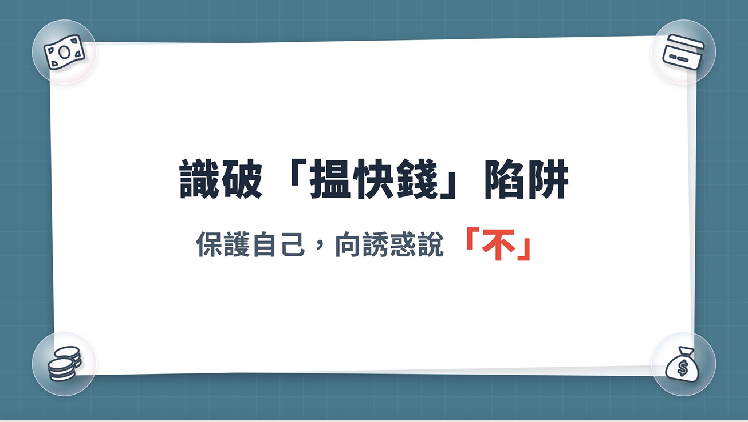
Spotting Quick Cash Traps: Say No to Temptation
Spotting Quick Cash Traps:
Say No to Temptation
6

Slide 7

Pay the price before reaping the rewards
Spotting Quick Cash Traps: Say No to Temptation
Watch the video
https://youtu.be/zMWuC2SbB3U?si=mzsbHWu8Q2X2dP_Y
7

Slide 8


Spotting Quick Cash Traps: Say No to Temptation
18
8
8

Slide 9
Spotting Quick Cash Traps: Say No to Temptation
Your Decision
【A】: Agree right away!
Whatever, my account barely has any money in it anyway, and I can always change the password whenever I want.
【B】: Test the waters first.
Tell him that you can try it once with your account, but demand half of the commission ($2,500) upfront as a deposit.
【C】: Decisively refuse and block.
There is no such thing as a free lunch in this world!
3
9

Slide 10
Think about it：
Spotting Quick Cash Traps: Say No to Temptation
In the “illegal debt collection” case, young people were paid from a few hundred to over one thousand Hong Kong dollars to splash red paint on properties.
What psychological weaknesses do you think the criminals took advantage of?
Immediate rewards outweigh awareness of legal consequences
The illusion of “easy money” with little cost
Peer pressure / desire of acceptance
Belief that minors won't have a criminal record
10

Slide 11
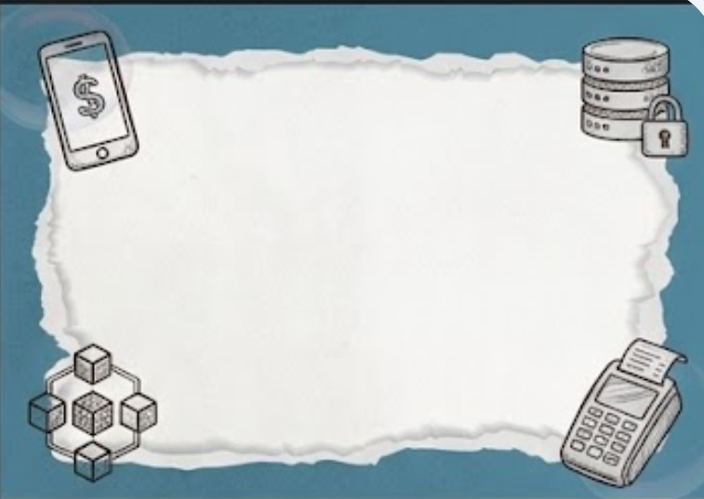


Does a “high-paying, low-effort” job really exist?？
Spotting Quick Cash Traps: Say No to Temptation
What might be the hidden cost behind these jobs?
11

Slide 12
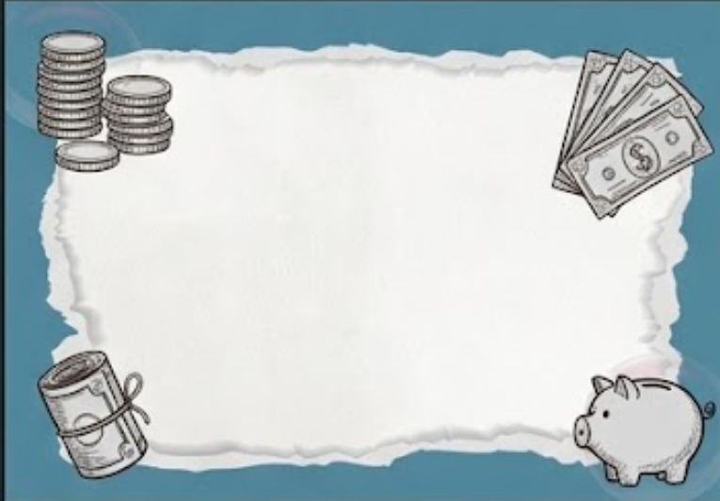
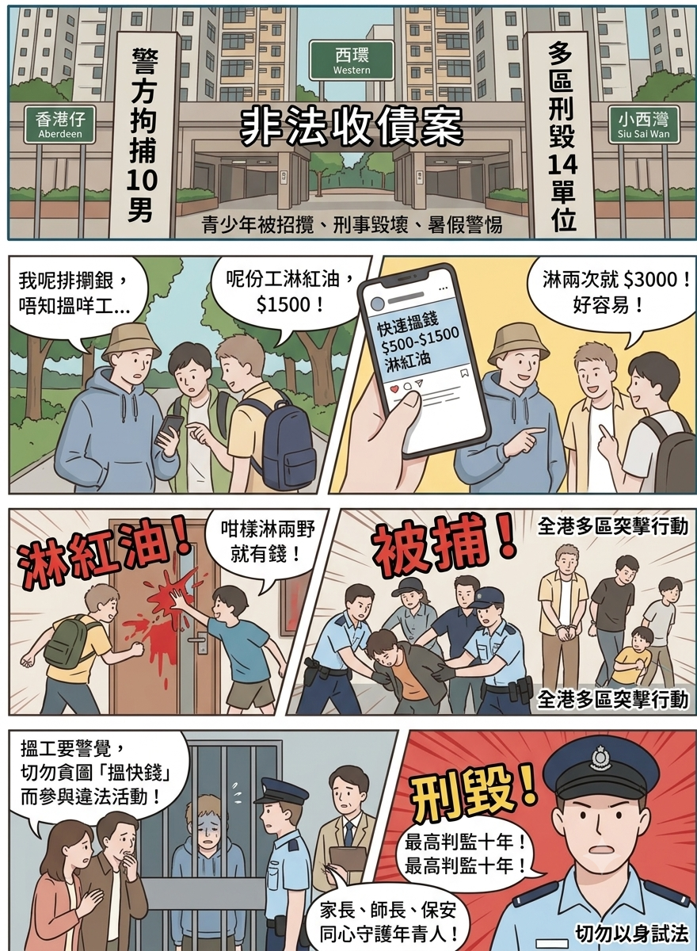
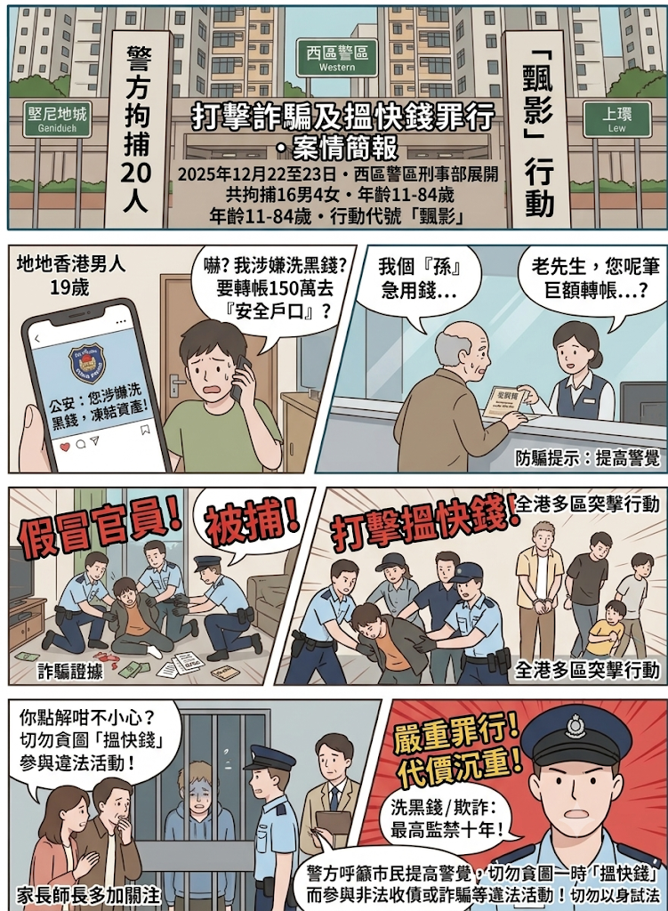
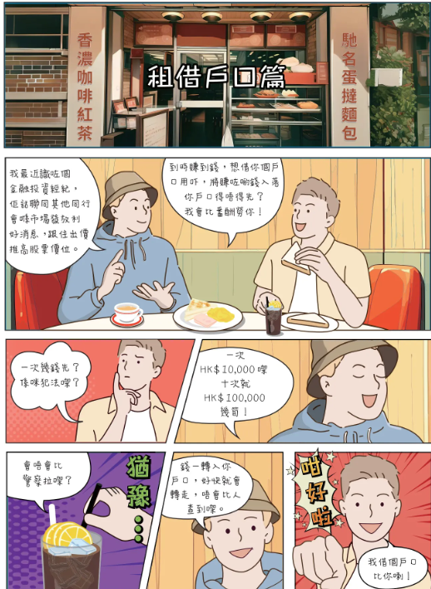

Case Discussion
12

Slide 13
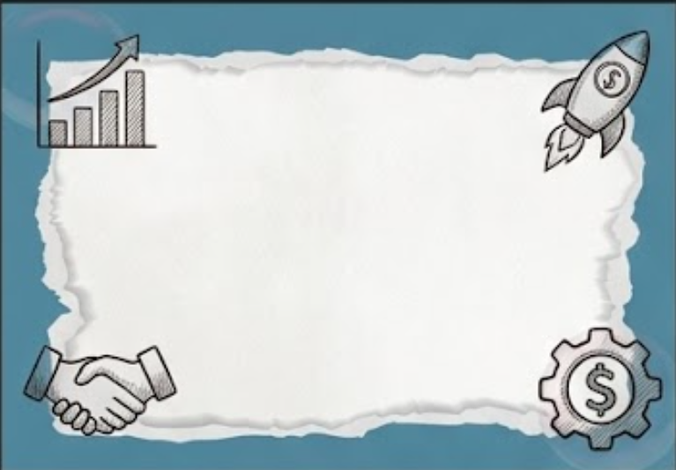
Spotting Quick Cash Traps: Say No to Temptation
"I was just helping to collect money / open a bank account / run errands.
I was not the person who cheated anyone, so the punishment should not be very serious, right?”
Do you agree？
13
https://www.police.gov.hk/info/ebook/fiib/2024/01/index.html#p=5

Slide 14
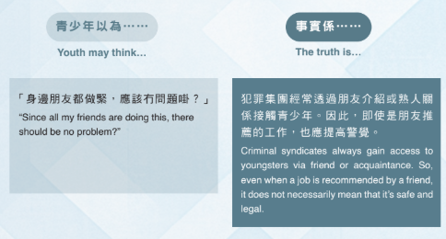
Spotting Quick Cash Traps: Say No to Temptation
Debunking Myths: The Quick Money Trap
14

Slide 15

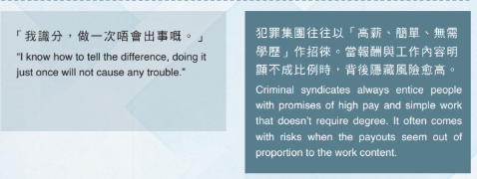
Spotting Quick Cash Traps: Say No to Temptation
15

Slide 16
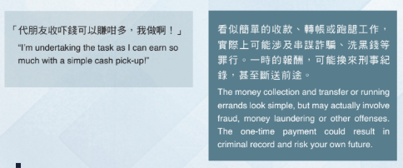
Spotting Quick Cash Traps: Say No to Temptation
3
16

Slide 17
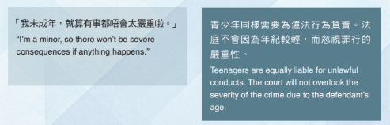
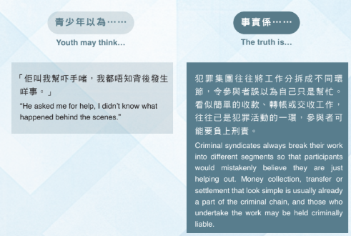
Spotting Quick Cash Traps: Say No to Temptation
17

Slide 18
Legal Consequence
Spotting Quick Cash Traps: Say No to Temptation
Theft: The maximum penalty is 10 years’ imprisonment.
Fraud: Upon conviction, the maximum penalty is 14 years’ imprisonment.
Money laundering: Lending accounts or handling illicit proceeds carries a maximum fine of HK$5,000,000 and 14 years imprisonment.
18

Slide 19
Devastating Impact on Your Future
Spotting Quick Cash Traps: Say No to Temptation
Limited options for further study: Universities may consider an applicant’s criminal record during interviews
or admission decisions, making further study more difficult.
Visa and travel restrictions: A criminal record may affect applications for a Certificate of No Criminal Conviction, overseas study, visas, and travel.
Risk of blackmail or being used as a scapegoat: Sharing personal information with criminals may lead to threats, blackmail, deeper criminal involvement, and more serious legal consequences.
Unable to obtain professional licences: Many professions require strict background checks, and a criminal record
may result in licensing refusal.
19

Slide 20

Spotting Quick Cash Traps: Say No to Temptation
20

Slide 21

Spotting Quick Cash Traps: Say No to Temptation
Identifying Red Flags ：
When we see part-time job advertisements online, or hear from friends about jobs that claim “Earn thousands of dollars a day”, “No experience needed” or “Instant payment”, how can we spot illegal activities?
Informal contact or interview arrangements
Required to borrow your personal bank account
Unusual job requirements
Required to provide identity documents or important personal information
Vague or secretive job duties
Required upfront payment
21

Slide 22
Can You Identify the Victims in the Case?
Spotting Quick Cash Traps: Say No to Temptation
22

Slide 23
Find Out
Spotting Quick Cash Traps: Say No to Temptation
In this case, flats were splashed with red paint.
Who was affected?
Who else was drawn into the incident?
23

Slide 24
Put Yourself in Their Shoes:
Spotting Quick Cash Traps: Say No to Temptation
In this case, fraudsters pretended to be Mainland Chinese officials. They accused victims of being involved in financial crimes and pressured them into handing over money.
Imagine the fear and helplessness experienced by the victims, especially older people.
24

Slide 25
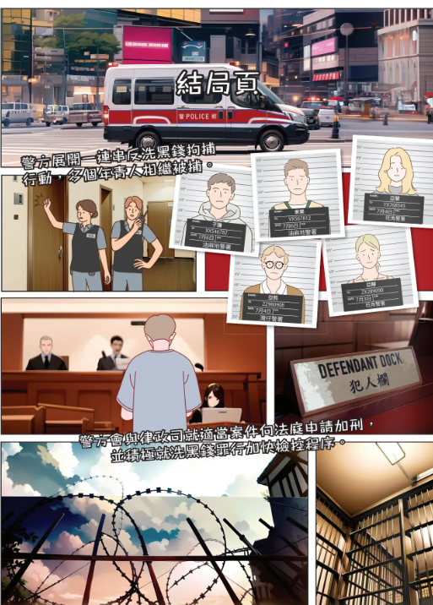
This is not just a financial scam.
It can destroy victims’ families, sense of security, and their future.
Spotting Quick Cash Traps: Say No to Temptation
25
https://www.police.gov.hk/info/ebook/fiib/2024/01/index.html#p=14

Slide 26
The Three Anti-scam Steps
Spotting Quick Cash Traps: Say No to Temptation
Disconnect：
Hang up immediately if an unfamiliar caller claiming to be a relative, official or customer-service representative asks about money, fines or personal information.
Verify：
Verify the caller’s identity and claims through official websites or phone numbers, or contact the relative or friend directly.
Seek Help：
If unsure or suspicious, seek advice immediately from family, friends, teachers or another trusted adult.
26

Slide 27

Anti-scam Video
Spotting Quick Cash Traps: Say No to Temptation
https://www.youtube.com/watch?v=aG9_Z3b9ddI
27

Slide 28

Spotting Quick Cash Traps: Say No to Temptation
Special Acknowledgement：
18

