Slide 1

Staying Away from Violence and Bullying
Task One: Making Friends
Self-Reflection
My Social Circle：At school, how many friends do you currently spend time with face-to-face and play with the most often on a daily basis?
A Safe Haven：Where do you and this group of friends enjoy gathering at school? (For example, in the corridor during recess, in the playground at lunchtime, or at the basketball court after school)
Expectations of Friends：When you feel upset, are excluded by others, or find yourself in trouble, what do you hope that this group of friends will do for you?
譚詠麟《朋友》：https://www.youtube.com/watch?v=cgrjjrXtKeQ
Mirror We All Are：
https://www.youtube.com/watch?v=9LFs-FrJokU
力臻《我的課本留白處》：
https://www.youtube.com/watch?v=Zuwc0f9uMRI

Slide 2
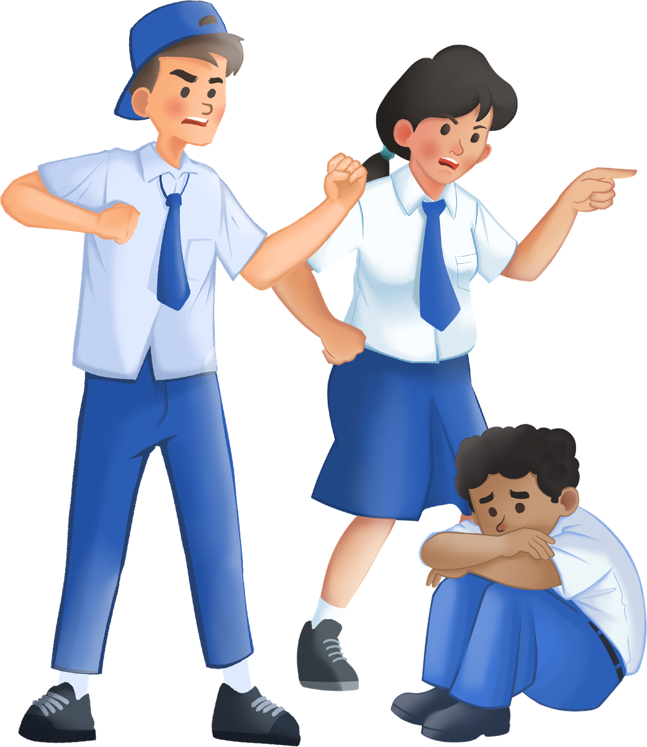
Staying Away from Violence and Bullying
Watch Video
https://youtu.be/8h3hvbSQMT8?si=yd5lt1mNmhJAcBUP

Slide 3
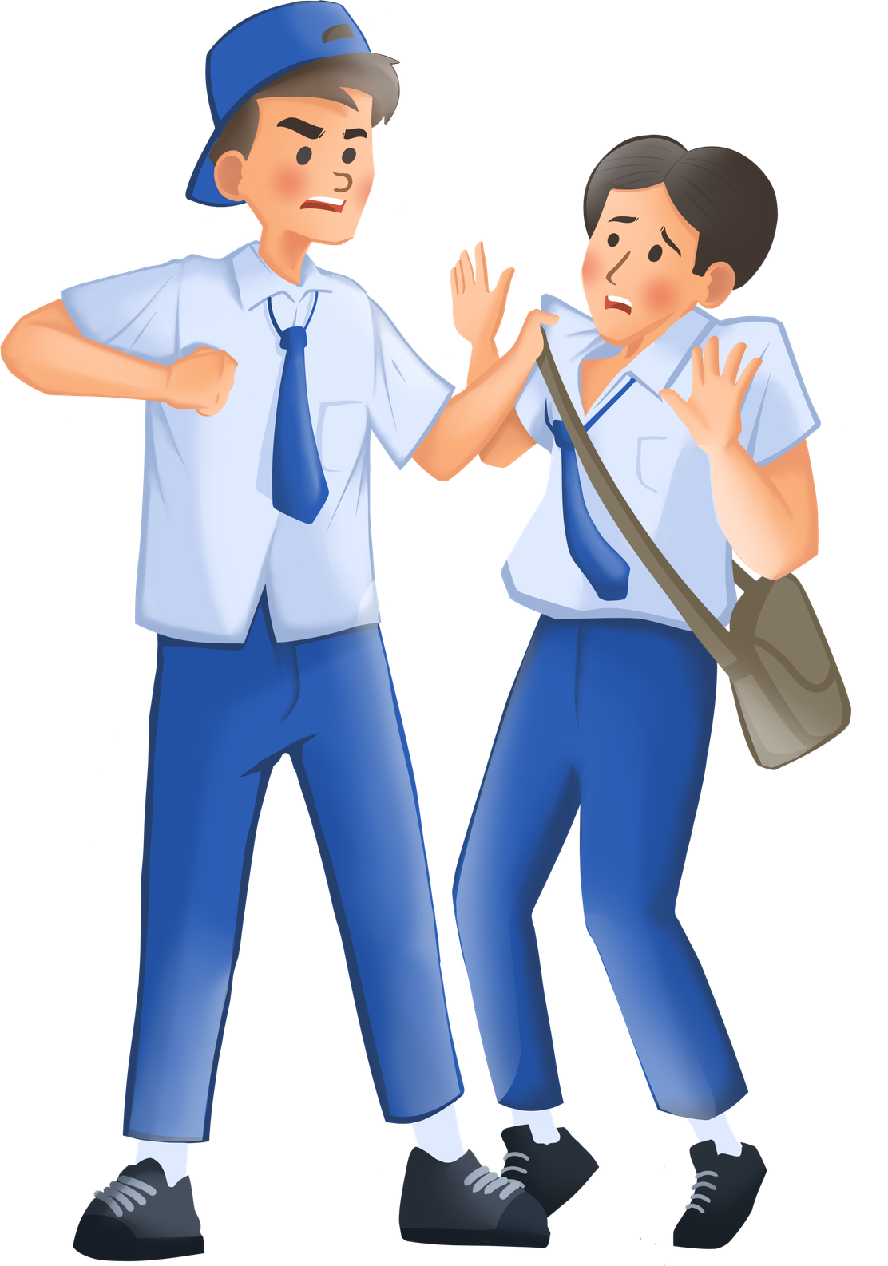
《Staying Away from Violence and Bullying》
Please present the “frozen action” at the exact moment of the incident:
1
2
The victim
The girl being “clawed”
“The bully”
The girlfriend
3
4
The aider”
Friend A (the one who slapped)
The spectator”
Friend B (the one who filmed)

Slide 4
《Staying Away from Violence and Bullying》
Task Two: The Claw Incident
Location of character | Name of character | Behaviour displayed (what they are doing/saying) | Inner feelings (what they are really thinking)
A. The victim
B. The bully
C. The aider
D. The spectator
The girl being “clawed”
Cornered, unable to fight back
Isolated, without support, terrified
Loudly impeaching, stirring up conflict
Raged, wanting to show off in front of peers
The girlfriend
Friend A (the one who slapped)
Appearing to act out of a sense of “loyalty”, feeling obliged to lend a hand
Listening to instructions, resorting to physical violence
Holding a phone to record, without any attempt to stop the incident
Amused, believing one to be fighting for “justice”
Friend B (the one who filmed)

Slide 5
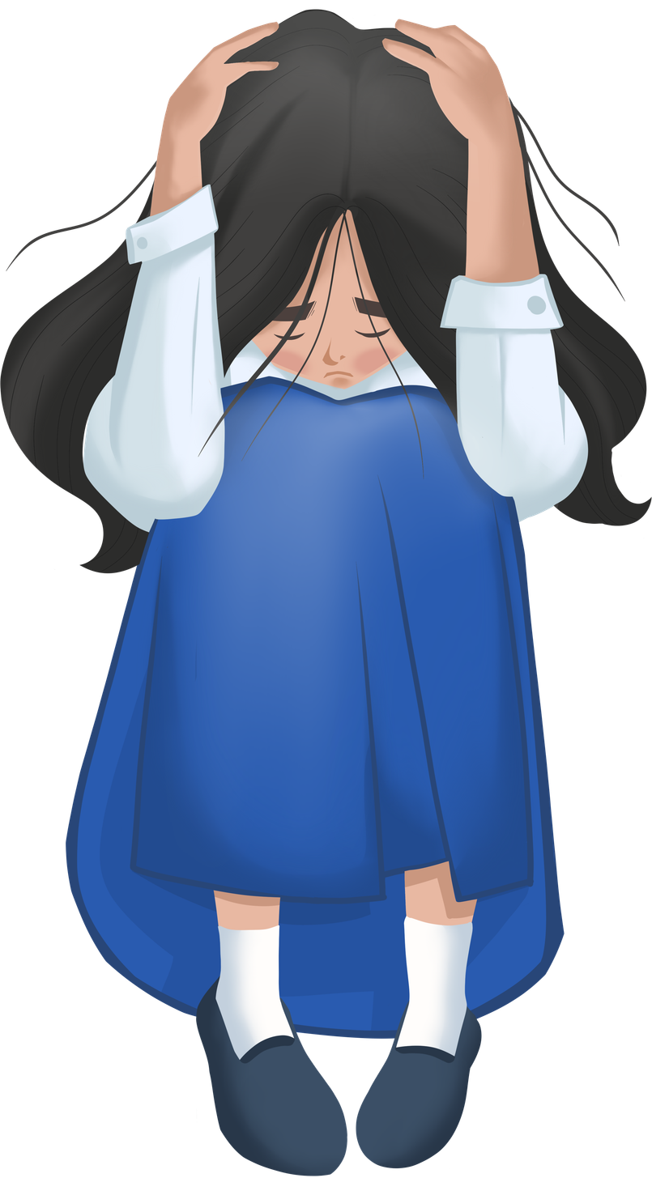
《Staying Away from Violence and Bullying》
Definition and Essential Elements of Bullying
Multiplicity － Bullying acts happen repeatedly over a period of time, rather than being a single incident.
Violence － Aggressive acts concerned in unwelcome and negative behavoiur.
Animus － The bully deliberately and oppressively harms others.
Countervailing power－The bully is manifestly stronger than the victim, and the bullying act happens in a case where the victim is failing to protect their own self.
References:
https://www.edb.gov.hk/attachment/tc/teacher/guidance-discipline-services/support%20service/harmonious-school-anti-bullying/harmonious-school.pdf

Slide 6
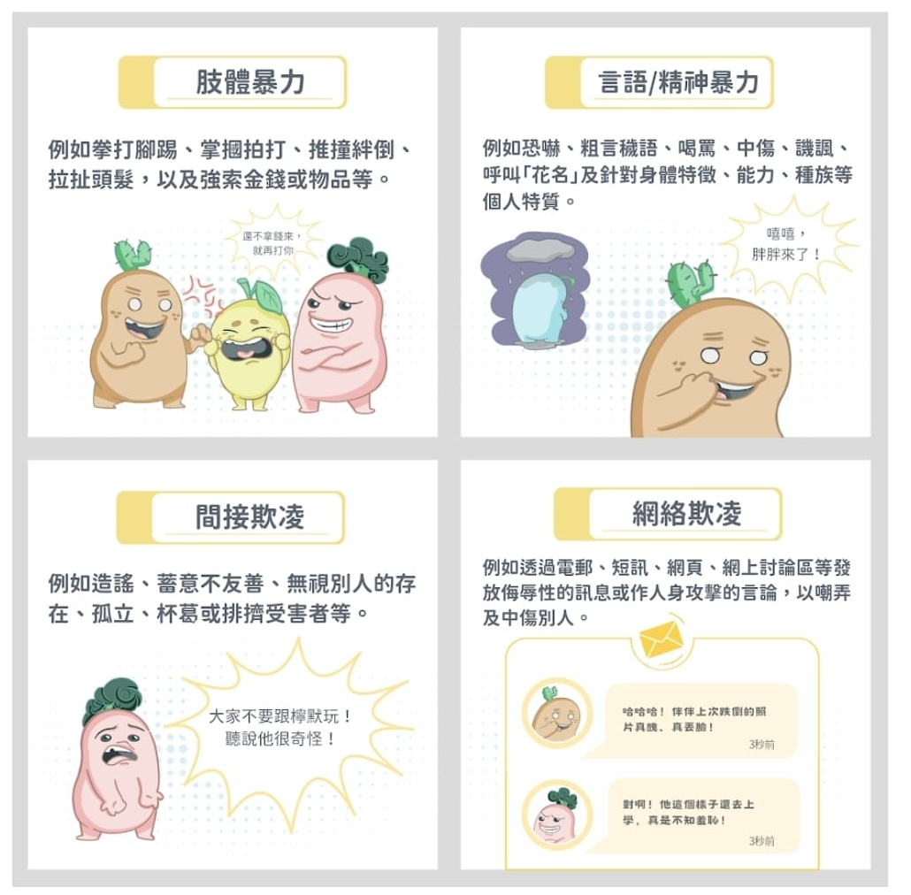
《Staying Away from Violence and Bullying》
In general, bullying behaviour can broadly be classified into the
following types:
The relationship between online bullying and physical violence has a violent nature at its core: although most online bullying does not involve direct physical contact, it incorporates serious verbal violence, intimidation, coercion, defamation, and doxxing, and is in essence a form of psychological and emotional violence.
Shoving, hitting, demanding money, or concealing another person’s belongings all constitute “physical violence” .It is important to learn to distinguish between” playful roughhousing” and “malicious violence”.
Jockey Club "Love & Respect" School Empowerment Programme https://share.google/2WdAPIJaKnvkgLVnT

Slide 7

《Staying Away from Violence and Bullying》
The police’s appeal
“Whether it takes the form of verbal abuse, doxxing, name-calling, ganging up on someone, physical violence, or online dissemination of bullying videos, such behaviour is irresponsible and may well constitute a breach of the law.”
https://www.facebook.com/watch/?v=1477204227353863
7

Slide 8
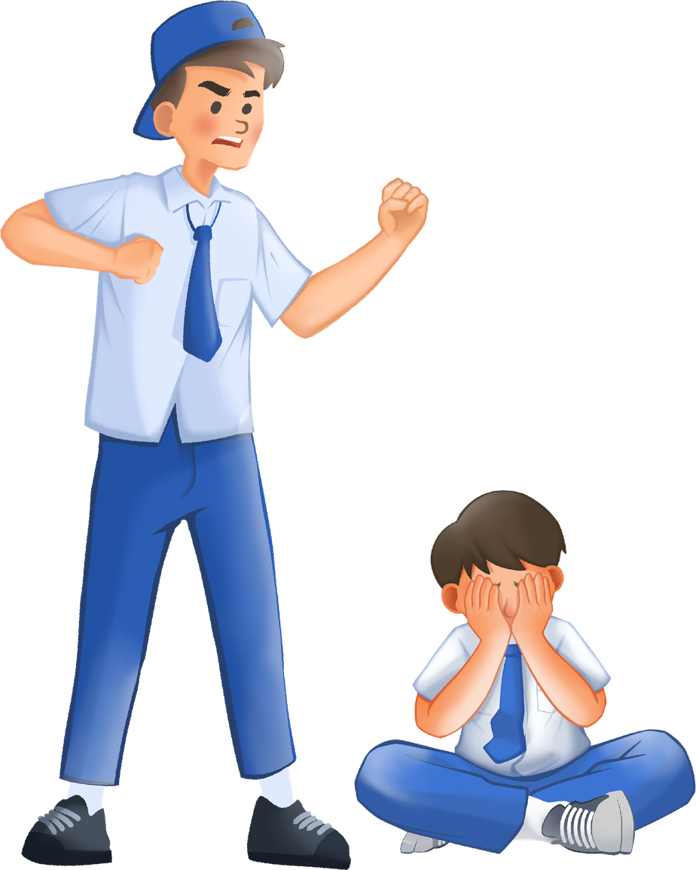
《Staying Away from Violence and Bullying》
Bullying can ruin the future
Limiting educational choices: Universities, when interviewing or considering admission, will review an applicant’s criminal record, making further study extremely difficult.
Visa and entry/exit restrictions: Once a criminal record is involved, the Police Department will generally not issue a certificate of good conduct, so applications for studying abroad, leaving the country, and similar matters will be restricted.
Inability to obtain professional licenses: Many professional positions in society require strict character assessments before a license can be granted. Once a criminal record is present, there is a high likelihood of being directly denied a license.

Slide 9
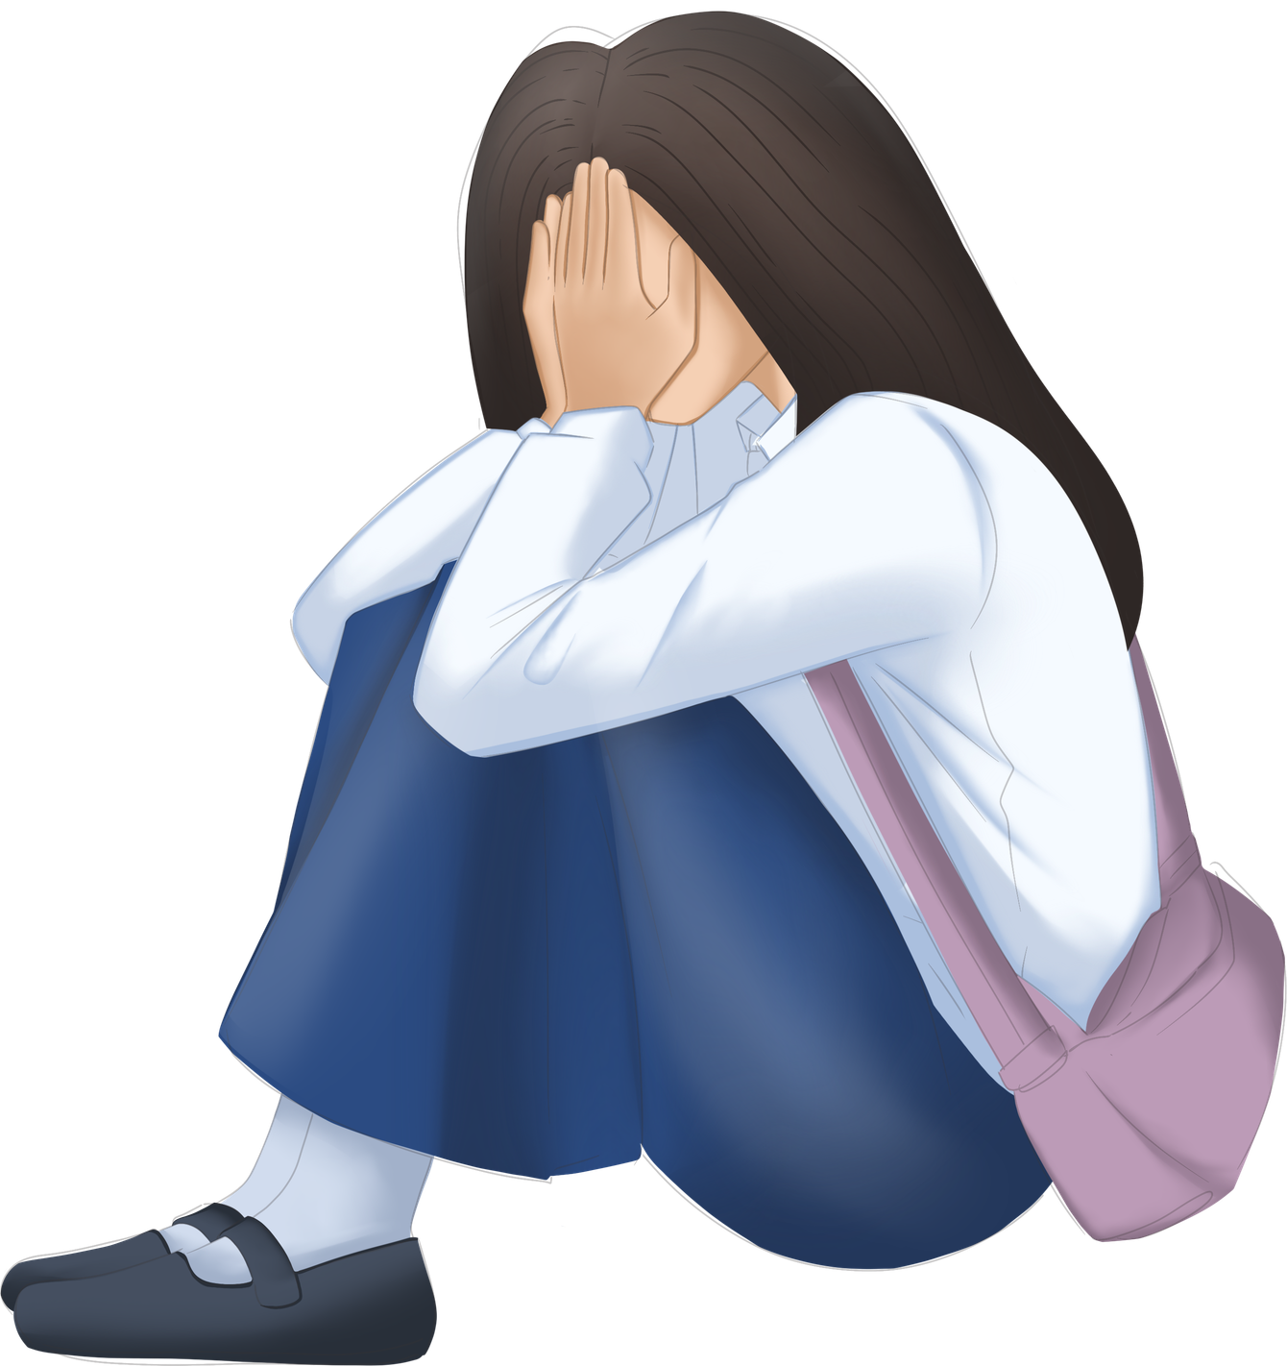
《Staying Away from Violence and Bullying》
Task Three: Pause and Consider
“Blindly back” or “intervene in time”?：
If your close friend bullies someone, is joining him in the assault “loyalty”, while personally pushing him toward crime and prison?
The “accomplice” behind the camera：
Staying silent at the scene, not intervening, only filming with a phone or uploading online – does that make you a “bystander from the outside”, or someone satisfying a curiosity and inflicting secondary harm on the victim as an “invisible bully”?
The art of refusal：
When your best buddy drags you to “teach someone a lesson”, how can you decline with a single sentence that does not damage the friendship yet successfully pulls you away?

Slide 10
Staying Away from Violence and Bullying
Task Three: Pause and Consider
1. If you want to stand up for a friend, does it necessarily require using violence?
Yes／No
2. If you are merely a bystander filming and not physically hitting anyone, does that mean that you have no responsibility? Yes／No
3. Does ‘loyalty’ equate to blindly agreeing with a friend? Yes／No
4. If a friend asks you to bully someone together,
how will you refuse and persuade him not to?

Slide 11
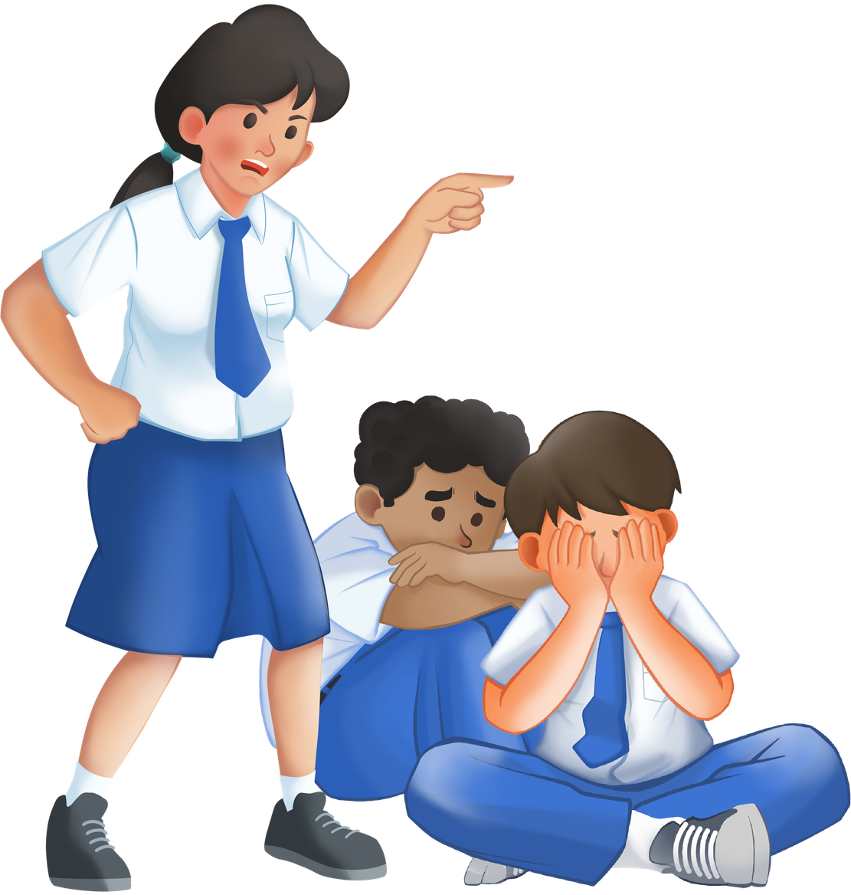
《Staying Away from Violence and Bullying》
Task Four: Group Discussion
The case from ‘A Guide for Teachers and Parents’ P.44-P.45
1. How does Hei “value loyalty”?
He/She endorses the use of violence, believing that if a friend has a problem, she should step in to help.
What price did Hei pay for this “conflict arising from emotional and financial disputes”?
A verbal argument escalated into a multi-person fight, leading to her arrest and ultimately a community service sentence.
The case caused her to lose an internship he/she had already secured.
His/Her impulsiveness not only affected himself/herself but also hurt his/her family, making his/her mother cry out of worry.

Slide 12
《Staying Away from Violence and Bullying》
Task Four: Group Discussion
What price did Hei pay?
For herself/himself🧑 | For his/her family👨‍👩‍👧 | For his/her future🌱
A verbal argument escalated into a multi-person fight, leading to her arrest and ultimately a community service sentence.
Her impulsiveness not only affected herself but also hurt her family, making her mother cry out of worry.
The case caused her to lose an internship she had already secured.

Slide 13
《Staying Away from Violence and Bullying》
Task Five: Role Play
Form pairs, and conduct a dialogue using Hei’s case.
Classmate A: “I am the victim“, “tell the bystander”
The fear, injury, and pain experienced when being excluded or physically harmed;
The feelings and emotions upon seeing others watching indifferently, even filming with their phones, which would become enablers of bullying;
Attempts to seek help from the “bystander”
Classmate B: “I am the bystander”
Listen to the “victim’s” feelings, reflect on your own behaviour, and consider shifting to an “active protector”;
Offer advice to the “victim”: When faced with physical threats, prioritise personal safety, decisively leave the scene, and immediately seek help from a teacher, parent, or other adult.

Slide 14
《Staying Away from Violence and Bullying》
‘NOT’ techniques for dealing with bullying:
N (No)：Stand firm, clearly say no to the bully, and do not participate or go along.
O (Off)：Decisively leave the scene. When faced with physical threats, prioritise protecting your own safety.
T (Tell)：Immediately report to teachers, parents, or a trusted adult, seeking third-party assistance.
Sample Script
【Classmate A】：I’m scared. They keep surrounding me.
【Classmate B】：I understand that you’re scared.
【Classmate A】：I don’t know what to do. Could you help me?
【Classmate B】：
N (No) ______________________________________________
O (Off) ______________________________________________
T (Tell) ______________________________________________
【Classmate A】：Thank you!

Slide 15
《Staying Away from Violence and Bullying》
Conclusion
Conflicts and dissatisfaction can arise in interpersonal relationships. You may dislike someone’s personality and can choose not to interact with them or keep your distance. However, when you resort to threatening language, doxing, mobbing, or even physical assault, it is no loner a matter of “disliking” but a matter of “choosing to commit violent crime”.
Whatever the other person has done, no one has the right to illegally harm another. If someone uses this excuse to beat another today, others can use the same excuse to hurt you tomorrow. That is why the law and schools must adopt a zero-tolerance stance toward bullying.
Treat others kindly, practise compassion and empathy, and build harmonious relationships
Resolve conflicts peacefully.
When facing bullying, prioritise your own safety and seek assistance.

Slide 16

《Staying Away from Violence and Bullying》
Extension: Poster Design
Design posters with anti-campus-violence slogans. Work together to create a campus environment where everyone can study and live with peace of mind.

Slide 17

Staying Away from Violence and Bullying
Special Acknowledgement：
17

